Slide 1
HERNIA and ABDOMINAL WALL DEFECTS
BY
PROF. TAREK GOBRAN
PROF. of GENERAL and PEDIATRIC SURGERY

Slide 2
DEFINITION
Protrusion of a viscus or part of it through a defect in the wall of the containing cavity
It is either internal or external

Slide 3
ETIOLOGY
Predisposing factors:
Increase of intra-abdominal pressure
Pregnancy
Congenital preformed sac
Undescended testis
Obesity
Collagen abnormalities

Slide 4
COMPOSITION
Sac
Coverings
Contents

Slide 5
Sac
Neck
Body
Fundus

Slide 6
Coverings
Layers of abdominal wall through which the sac passes

Slide 7
Contents
Omentum ----- omentocele
Intestine ------ entrocele
Ovary ,tubes
Portion of intestinal wall ---- Richter’s H
Meckel’s diverticulum ---- Littre’s H

Slide 8
Complications
Irreducible
Obstructed
Inflamed
Strangulated

Slide 9
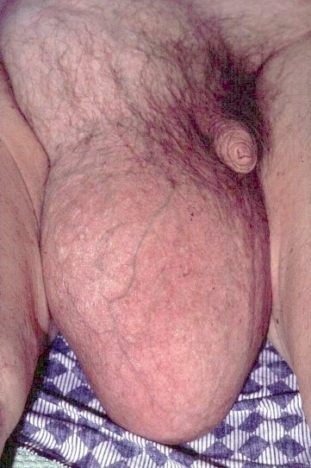
IRREDUCIBLE HERNIA
Contents can not reduced back to abdomen
Causes:
- Adhesions
- Large contents and narrow neck

Slide 10
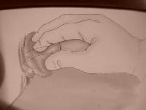
Hernia content balloons over external ring when reduction is attempted.

Slide 11
Obstructed Hernia
Irreducible hernia with obstructed intestinal lumen without interference with blood supply
Clinically ----- colic, constipation, vomiting, .......
Sometimes it is difficult to differentiate from strangulation so it is better to be managed as strangulated hernia

Slide 12
Strangulated hernia
= Serious impairment of blood supply of the contents with or without obstruction ----- ischemia ----- if not treated within 5-6 hrs ------ gangrene
In strangulation venous impairment occurs first ---- intestinal congestion & edema ------- more congestion &edema ----- arterial impairment ------ ischemia ---- exudation of blood into the sac + bacterial transudation through the wall ( infected toxic fluid in the sac ) ------ gangrene ----- perforation

Slide 13
Clinical Features
Sudden onset of pain +/- signs of intestinal obstruction
Local signs:
Irreducible
No impulse with cough
Tense
Tender
If not treated early ----- perforation ----- peritonitis ----- septic shock

Slide 14
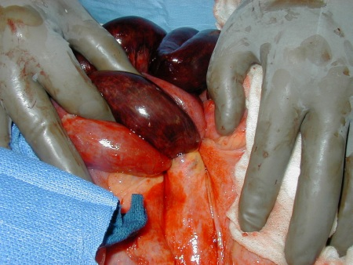

Slide 15
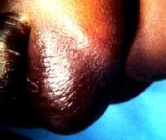

Slide 16
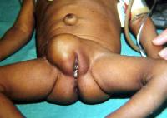
Strangulated hernia without obstruction
Strangulated omentum
Strangulated ovary
Richter’s hernia
Littre’s hernia

Slide 17
Inflamed Hernia
Source of infection:
-Inflamed contents as appendix
- From skin infection as ulcerations
Clinical features:
- Hernia is painful, hot red and tender but not tense

Slide 18
TREATMENT OF HERNIA
Truss ???????????????????????????????????????????
Surgery
Herniotomy
Hernioplasty
Herniorrhaphy

Slide 19
CAUSES OF RECURRENCE

Slide 20
PREOPERATIVE CAUSES
Causes of increased intra-abdominal pressure as chronic cough ----
Debilitating disease
Weak musculature

Slide 21
OPERATIVE
Repair undertension
Imperfect hemostasis and devitalization of tissues ----- infection
Use of absorbable suture
Missed sac or failure to completely excise the sac

Slide 22
POSTOPERATIVE
Persistence of predisposing factors as------
Wound infection
Lifting heavy objects early postoperatively

Slide 23
Incidence:
Excluding incisional h
75% inguinal
15% umbilical
8.5% femoral
1.5% rare hernias

Slide 24
INGUINAL HERNIA
Indirect Hernia (oblique inguinal hernia )
Direct hernia

Slide 25
INDIRECT INGUINAL HERNIA

Slide 26
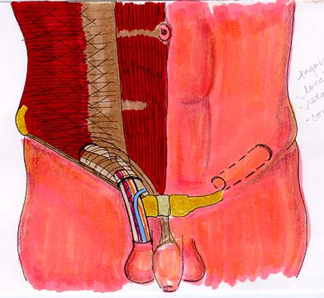
ANATOMY of INGUINAL CANAL
Inguinal canal is an oblique canal extending from internal (deep) ring to external (superficial) ring
It is about 4 cm in adult and in infants the two rings are opposite each others

Slide 27
INTERNAL (DEEP) RING
Opening in in fascia transversalis ½ an inch above the mid-inguinal point medial to inferior epigastric vessels

Slide 28
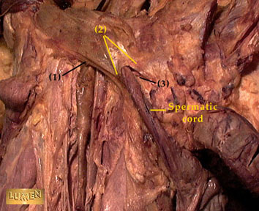
External Ring
opening in external oblique apponeurosis ½ an inch above pubic tubercle bounded by supromedial and infrolateral crus of ext ob . Normally it just admit the little finger

Slide 29
Contents
Male ------ spermatic cord + ilio-inguinal n +genital branch of genitofemoral n.
Females: Round ligament + -------

Slide 30
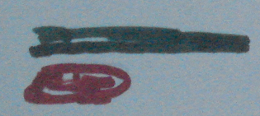
Boundaries
Anterior:
External oblique apponeurosis +
Conjoint tendon medially

Slide 31
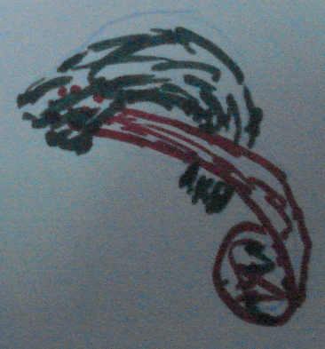
Posterior
Fascia tranversalis +
Conjoint tendon laterally

Slide 32
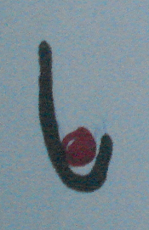
Superior
- Conjoint tendon
Inferior
-Inguinal ligament

Slide 33
Mechanisms that prevent hernia
Shutter mechanism
Valvular mechanism
Plugging mechanism

Slide 34
Indirect Hernia (OIH)
It is a hernia that pass through the internal ring and enter inguinal canal (bubonocele) and may pass through external ring and descend in scrotum (complete)

Slide 35
INCIDENCE
Commonest type of hernia
Male: female 20:1
Common in right side
Bilateral in 30%

Slide 36
Etiology
Congenital preformed sac ( patent procesus vaginalis) ------- most accepted
More common on the RT side
Herniotomy only in children is curative
PPV is found in many autopsy of individual with no history of hernia

Slide 37
Incidence
It is most common hernia
More common on RT side ------- why?

Slide 38
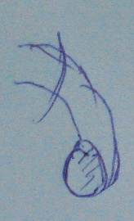
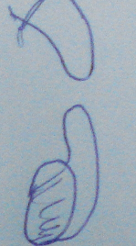
Types of the sac
Congenital
Infantile

Slide 39
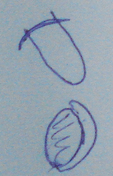
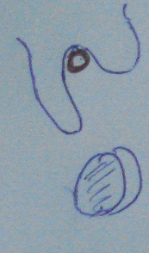
Funicular
Saddle hernia

Slide 40
Bubonocele
Complete hernia

Slide 41
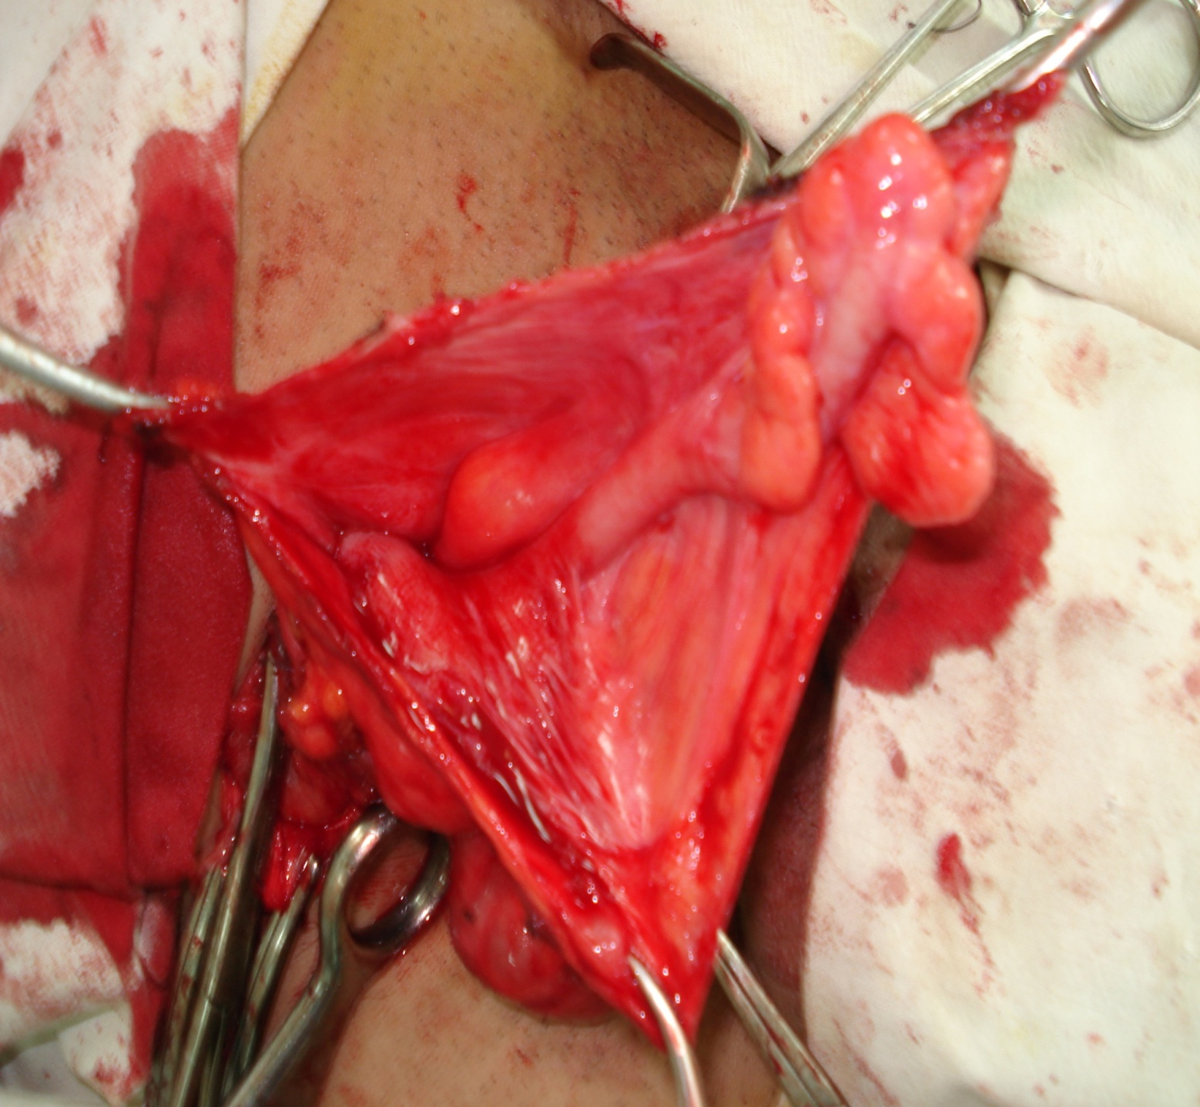
Sliding hernia

Slide 43
Contents
As before

Slide 44
Descent
Downward, forward and medially ( reduction in reverse direction)

Slide 45
Coverings
Extrapertitonial fat
internal spermatic fascia |(fascia tranversalis)
cremastric muscle and fascia
(from internal oblique)
External spermatic fascia (external oblique)
skin and superficial fascia

Slide 46
Complications

Slide 47
Clinical features

Slide 48
INSPECTION

Slide 49
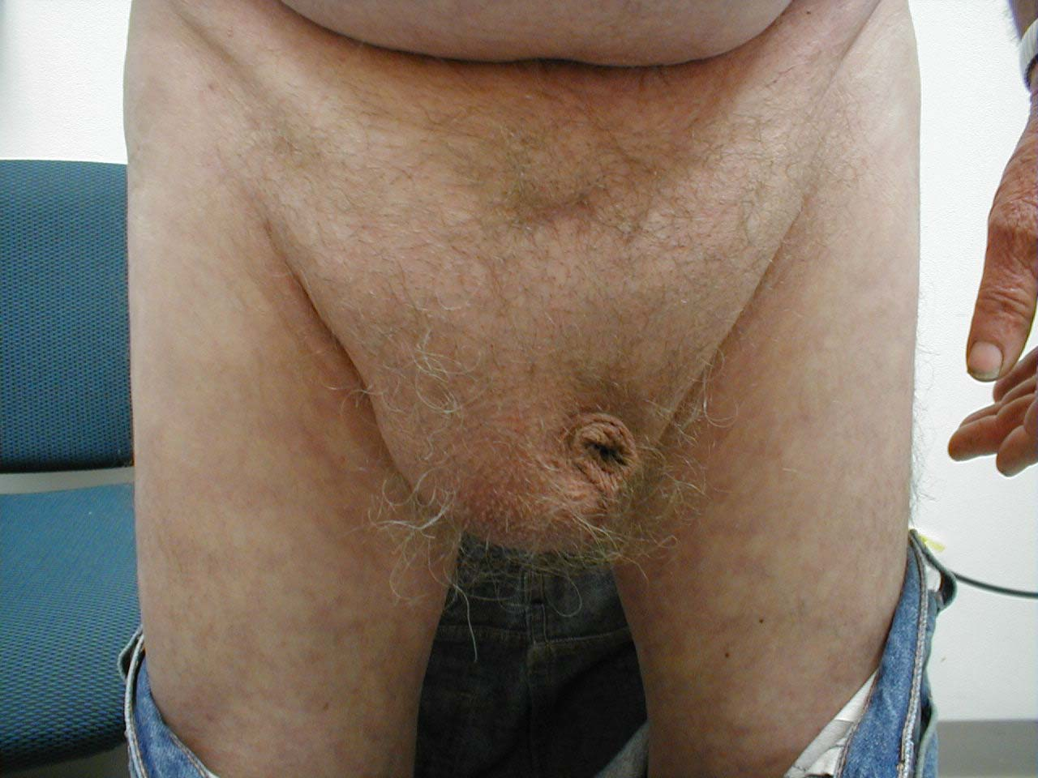

Slide 50
Palpation

Slide 51
Scrotal neck test

Slide 53
External Ring Test

Slide 55
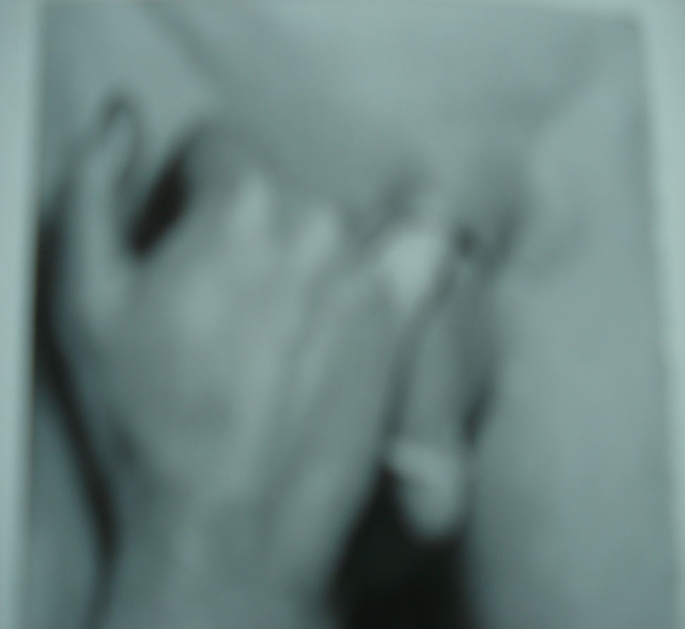

Slide 56
3 fingers

Slide 57
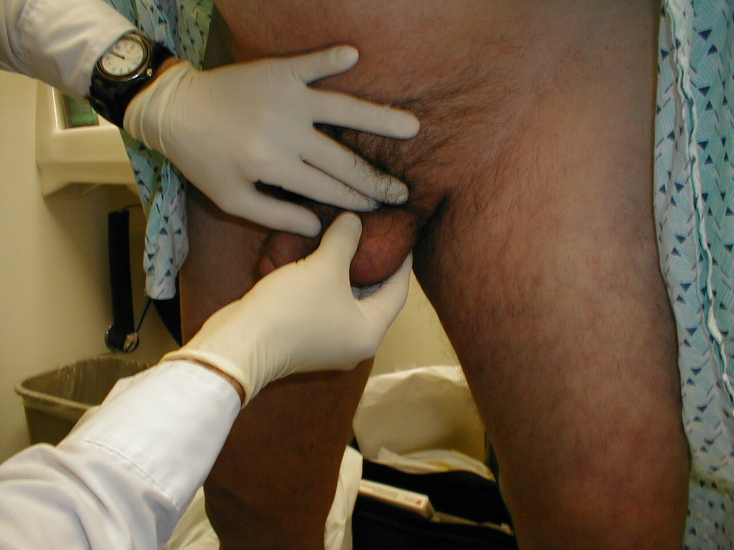
Testicular exammination

Slide 61
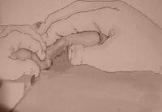
Hernia can be reduced by medial pressure applied first.

Slide 62
Translumination

Slide 63
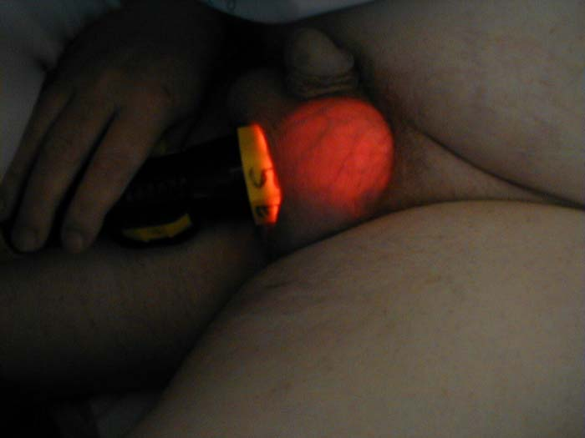

Slide 64
Differential diagnosis

Slide 65
Treatment
Correct predisposing causes
Surgery

Slide 66
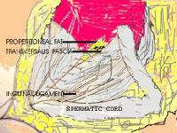
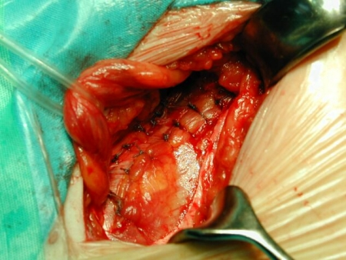

Slide 69
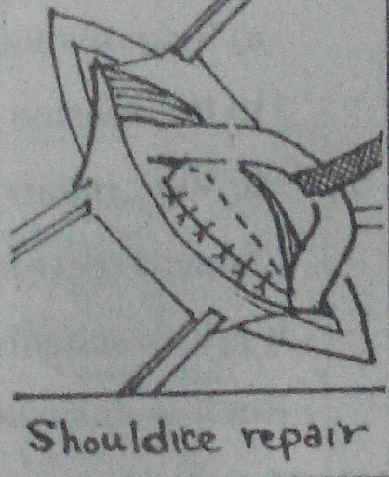
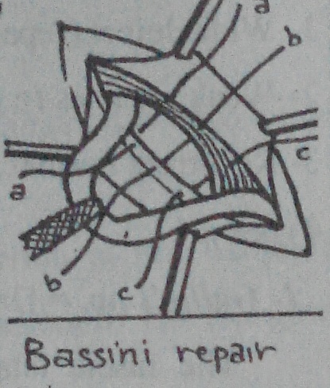

Slide 70
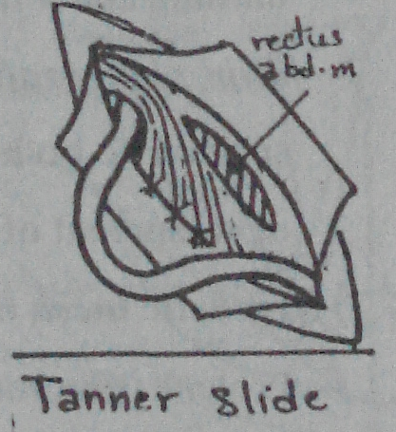
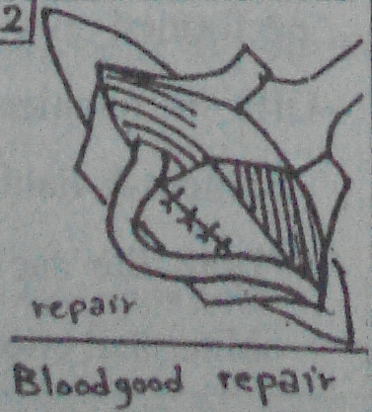

Slide 71
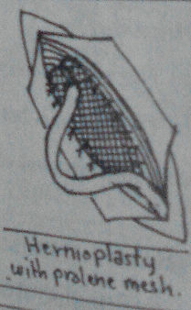
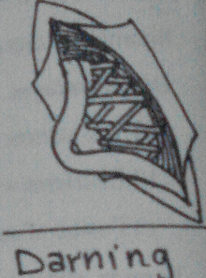

Slide 72
DIRECT INGUINAL HERNIA

Slide 73
INCIDENCE
15% of inguinal hernias
Always in male
More than 50% bilateral

Slide 74
Hernia through weak Hasselbach’s triangle
Lateral defect : Malgaigne bulge
Medial defect; narrow neck

Slide 75
ETIOLOGY
Acquired
Weak conjoint tendon
Injury of ilioinguinal nerve
Precipitating factors

Slide 76
CONTENTS
Sliding urinary bladder is common

Slide 77
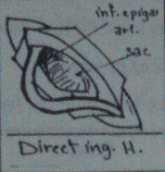
COVERINGS
Extraperitonial fat
Fascia transversalis
Conjoint tendon
External oblique aponeurosis
Skin and sc tissues

Slide 78
Descent
Forward ( very rarely pass through external ring)

Slide 79
COMPLICATIONS
Rare ---- why?

Slide 80
Treatment
surgery

Slide 81
FEMORAL HERNIA
Herniation through femoral canal
About 20% of hernia in women & 5 % in men
Female to male 2:1 ( elderly females and 30 to 40 years old males)
More in multipara.
Most liable to become strangulated and may be the first presentation why?

Slide 82
More in females:
Wider canal
Pelvic tilt
Repeated pregnancy

Slide 83
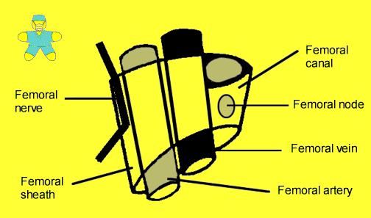
Surgical Anatomy
Femoral Sheath:

Slide 84
Femoral Canal
Most medial compartment of femoral sheath
Extend from femoral ring to saphenous opening

Slide 85
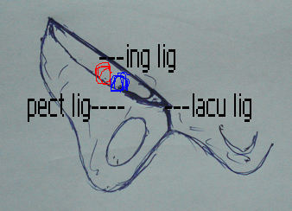
Boundaries of femoral ring
Anterior ---- Inguinal ligament
Posterior ------ Pectineal ligament
Medially ----- Lacunar ligament ( Cooper’s lig.)
Laterally ----- Femoral vein

Slide 86
Contents
Fat
Lymphatics
L.N of Cloquet
Closed by cribriform fascia (below) & condensation of extraperitoneal tissue – septum crural ( above)

Slide 87
Abnormal Obturator Artery
30% of cases
Replaces obturator art.
Arises from epigastric art (pubic branch) ---- passes behind lacunar ligament ---- obturator foramen

Slide 88
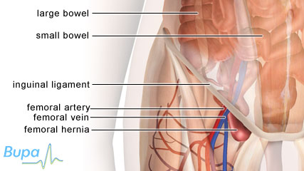
Descent

Slide 89
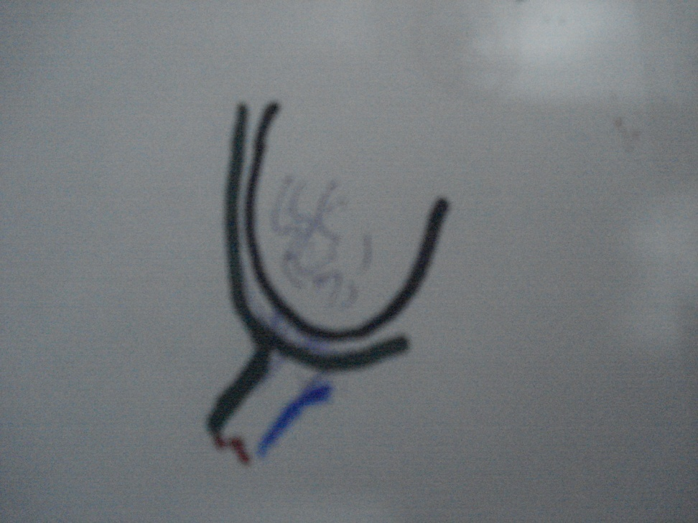
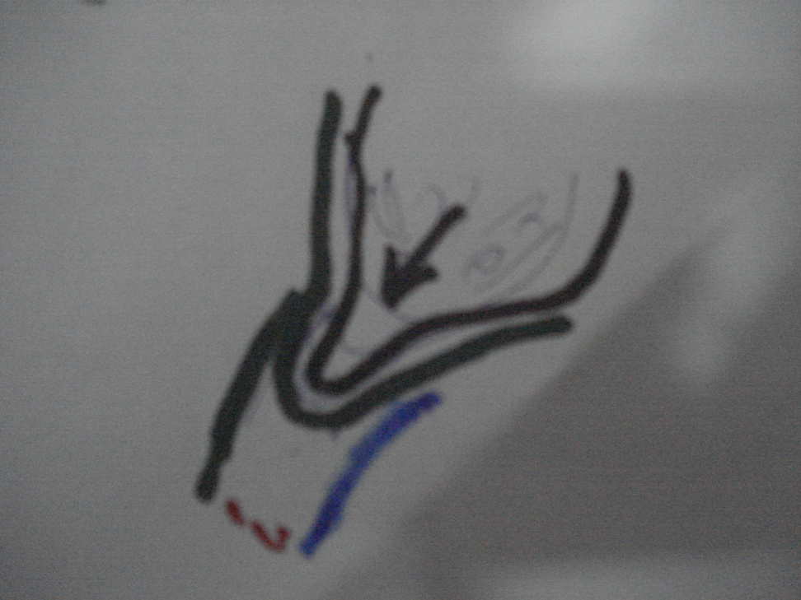
Coverings

Slide 90
Contents

Slide 91
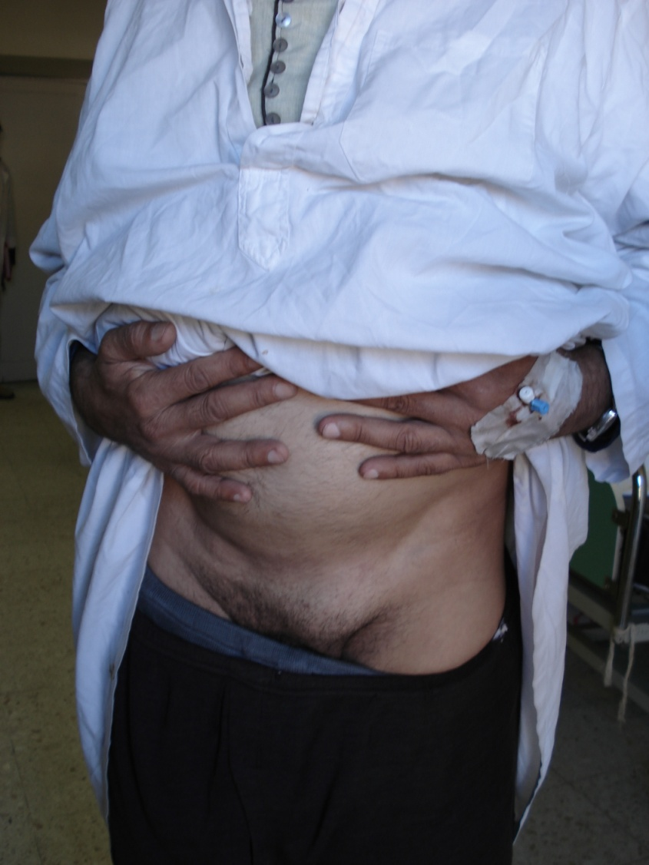

Slide 92
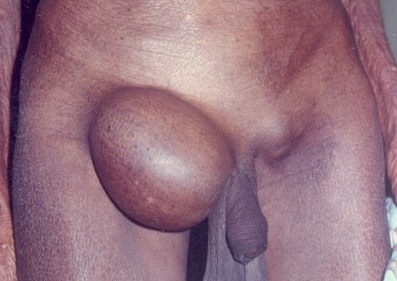
Complications

Slide 93
TRETMENT
Low approach
Poupart, lig to pectineal lig
Easy & rapid
Don,t disturb ing canal anatomy
But ----
Sac is not completely excised
Injury of abnormal obturator art

Slide 94
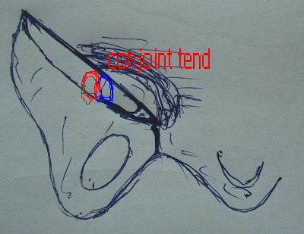
High approach
Cooper iliopectineal), to conjoint or
Poupert to pectinal or the 3 lig

Slide 95
Umbilical Hernia

Slide 96
Umbilical Hernia
Congenital
Infantile
U.H. in adults

Slide 97
Congenital = Exomphlos= Omphalocele
= Persistence of the physiologic hernia of fetal life

Slide 98
Coverings
2 layers
Inner peritonial
Outer amniotic membrane

Slide 99
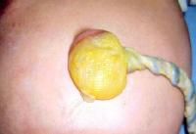
Types
Minor --- small defect with cord attach to its center

Slide 100
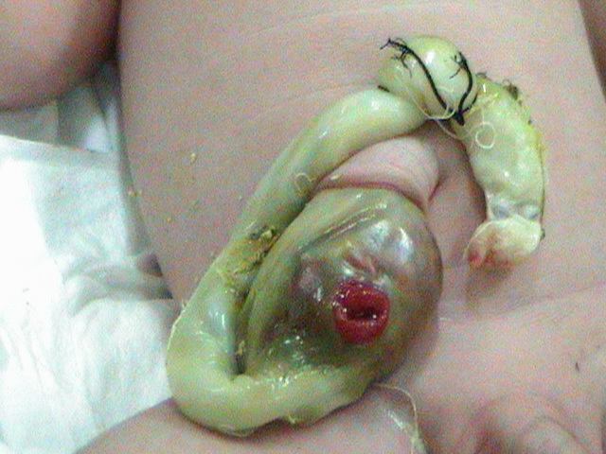

Slide 101
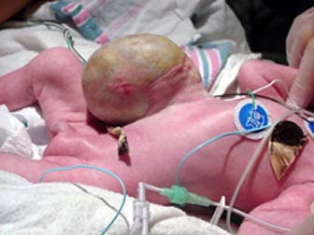
Major ---- wide defect with the cord attach to its lower part

Slide 102
Contents

Slide 103
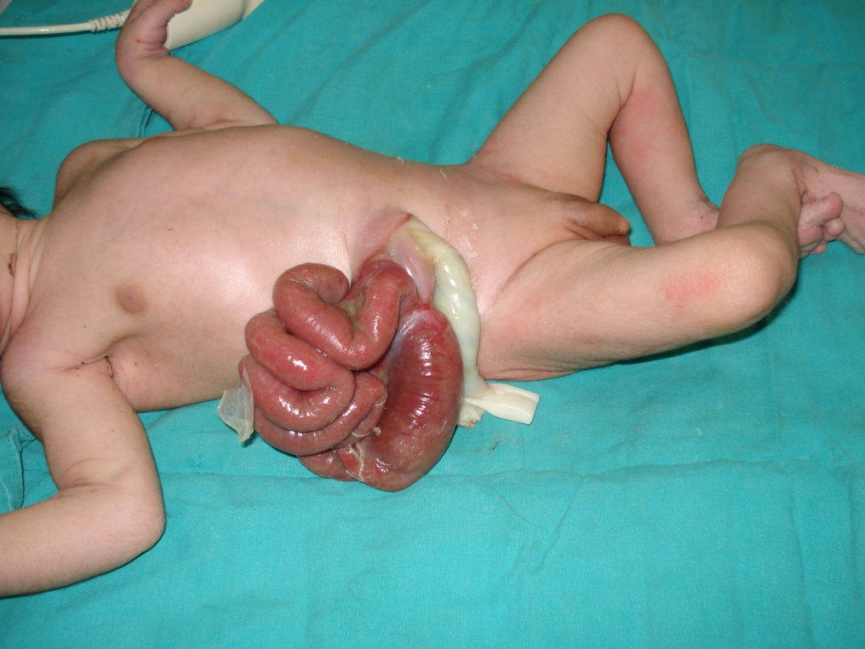
Complications
Intestinal injury during labr---- fecal fistula
Rupture ---- peritonitis
Associated anomalies

Slide 104
Treatment
Small defect ------- primary closure
Large defect
- Primary closure
-Skin flap closure
- Nonoperative ---- repeated painting with betdine, gentian violot, etc ------ ventral hernia --- repair

Slide 105
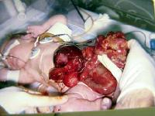
GASTRISCHISIS

Slide 106
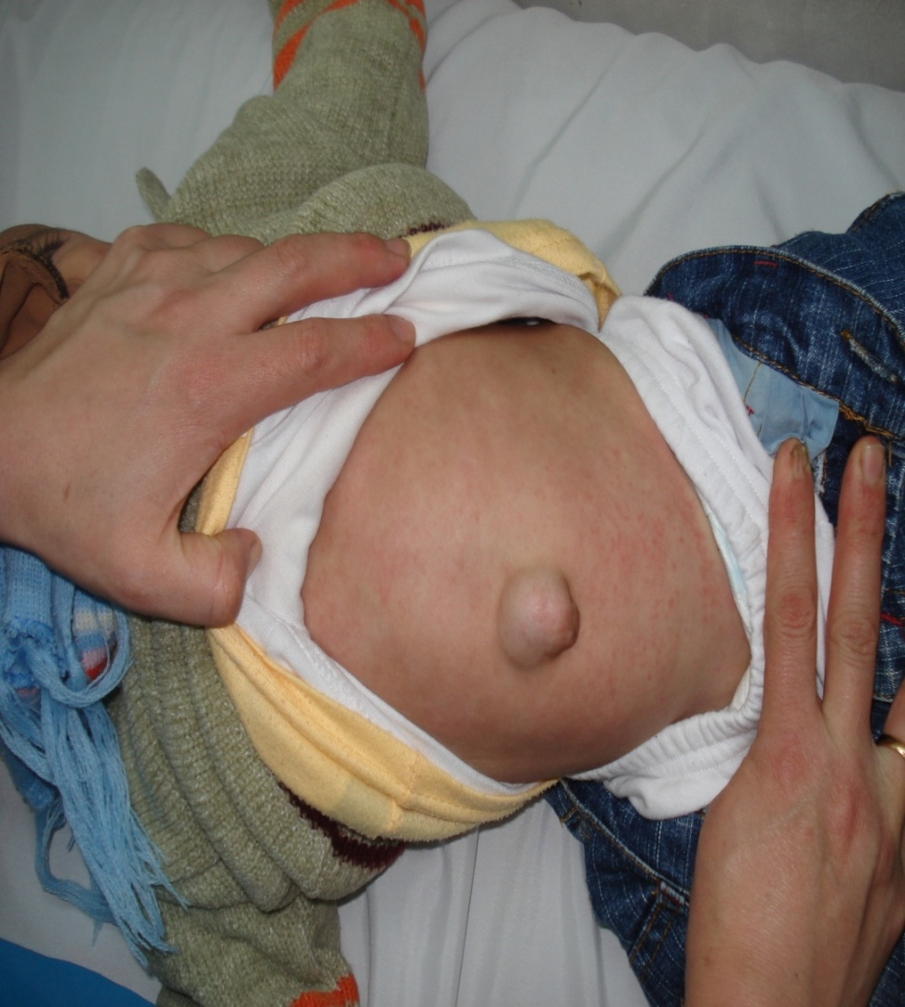
Infantile Umbilical Hernia
Due to weak umbilical scar
Rarely complicates
Spontaneous cure
If persist for 2-4 years or large --- repair

Slide 107
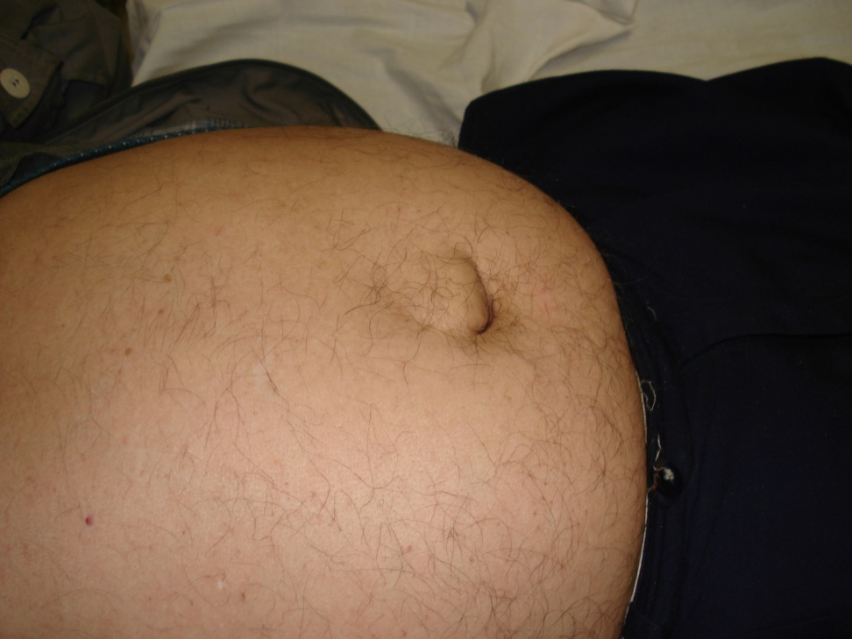
Umbilical Hernia in adult= Paraumbilical
Protrusion through linea alba just above or may be below the umbilicus (supra or infra umbilical)

Slide 108
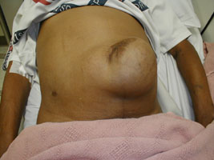
Sac
The neck is often remarkably narrow compared to the size of the sac ------ complication
Longstanding ----- loculated & adhesions

Slide 109
Contents
As any hernia but commonly omentum

Slide 110
Predisposing factors
+ Obesity , weak abdominal ms, repeated pregnancy

Slide 111
Clinical features
As any hernia
More in women 5 times men
Usually obese
35-50 years

Slide 112
Complications
+ dyspepsia ( dragging on colon & stomach)
Large hernia --- intertrigo

Slide 113
Treatment
Preop ----- + weight loss

Slide 114
Herniorrhaphy by primary closure ( small defect)
Mayo, repair
Hernioplasty ---- large defects & recurrent cases
+/- lipectomy & abdominplasty

Slide 115
Epigastric Hernia = Fatty hernia of the linea alba
Site: Through linea alba anywhere between the umbilicus & xiphoid process usually midway ( MORE THAN ONE DEFECT MAY BE PRESENT
Contents --- extraperitoneal fat ( fatty hernia of-----

Slide 116
Clinical Features
No symptoms
Symptoms of peptic dyspepsis

Slide 117
TREATMENT

Slide 118
Rare Hernias

Slide 119
Lumbar Hernia
Primary
Inf lumbar triangle
( commonest)
-Between iliac crest , ext oblique , latissmus dorsi
Sup lumbar triangle ----12th rib ,internal oblique , sacrospinalis
Secondary commoner

Slide 120
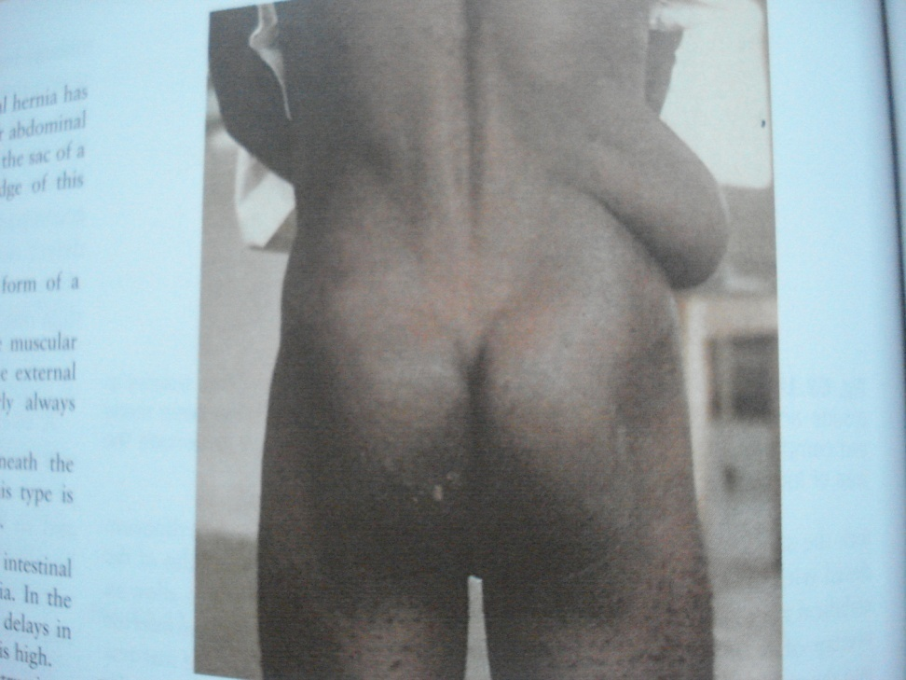
D.D
Lipoma
Cold abscess
Phntom hernia ( paralysis of muscles)

Slide 121
TREATMENT

Slide 122
Spigilian Hernia
Hernia thr ough linea semilunaris lateral to rectus m. midway between umbilicus and symp pubis

Slide 123
Divarication of the Recti
In multiparous women, ascitis ……. Etc
Infants

Slide 124
Incisional Hernia = Ventral = Postoperative
HERNIA at the site of abdominal scar

Slide 125
Aetiology
Preoperative ----as in rec hernia

Slide 126
Operative
Type of the incsion ---
-Vertical transvrse
Muscle cutting muscle splitting
Sepsis --- pertonitis
Injury top nerve supply

Slide 127
Closure of the wound under tension --- ischemia --- weak scar
Improper hemostasis -- hemastoma --- infection
Improper technique --- devitalization of the tissues ---- infection
Improper closure of the wound
Imprpoer anaethesia
Improper suture material

Slide 129
Postoperative
As in rec hernia + wound infection

Slide 130
Clinical Features

Slide 131
Treatment
Palliative : very poor risk patients with uncomplicated hernia with wide neck
Surgery

Slide 132
Surgery
Preoperative:
- As U.H

Slide 133
Surgical Procedures
Anatomical repair
Cattle, 5 layers
Keel, ( historical)
Hernioplasty

Slide 134
Burst Abdoen = Abdominal Dehiscence
Etiology as in incisional hernia

Slide 135
Types
Complete
Incomplete

Slide 136
Incidence
1-2 %

Slide 137
Clinical Features
6th to 8th postop day ---- serosanguinous discharge ( pathognomonic -------

Slide 138
Treatment
Emergency operation
Preoperative:
Reassure
- Resuscitate
NGT
Cover the intestine with sterile towel

Slide 139
Diseases of the Umbilicus
Congenital
Inflammatory
Neoplastic
Fistula
Others

Slide 140
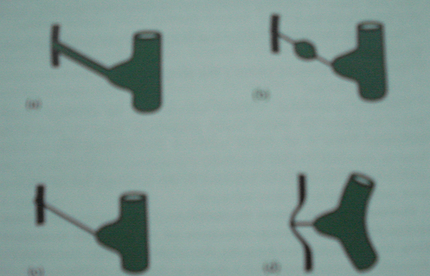
Congenital
Hernia
Urachus
Urachal cyst
-Patent Urachus (fistula)
Vitellointestinal
Fistula
Entrogenos cyst
Band

Slide 141
Inflammatory
Neonatal omphalitis --- infection of umbilical stump
Adult omphalitis
Pilonidal sinus

Slide 142
Benign Neoplasms
Adenoma (Raspbery tumor) in infants from vitellointestinal duct mucosal reminant
Endometriosis

Slide 143
Malignant Neoplastic
Primary epithelioma (rare) ----- inguinal & axillary LN
Secondaries ( sister Joseph nodule) --- breast, stomach, colon,

Slide 144
Fistula
Fecal --- congenital , malignant infiltration of cancer colon, T.B. peritonitis
Urinary
Biliary (subacute perforation of gall bladder)

Slide 145
Others
Umbilical stone
Umbilical polyp

Slide 146
Desmoid Tumor
Desmo = tendon like

Slide 147
Incidence Adult multiparous female (80% females)
Site Rectus sheath usually below the umbilicus never in the mid-line but other abdominal muscles can be affected

Slide 148
Aetiology
Female who have borne children
Rarely arises from old abdominal scar
May be associated with familial polposis ( Gardner sayndrome)

Slide 149
Pathology
Composed of fibrous tiossues containing multinucleated masses resemble F.B giant cells , infiltrate muscles
No distant metastasis
Myxomatous degenration --- rapid increase in size
Never undergoes sarcomatous changes ( unlike fibroma)

Slide 150
Treatment
Wide excision ( at least 2.5 cm safty margin)

Slide 151
Rupture inferior epigastric artery

Slide 152
Incidence
Old age, thin weak females
Athletic below middle age males
Pregnant multi female ( late in pregnancy)

Slide 153
Site
Usually at the level of arcuate ligament where post rectal sheath is defecient

Slide 154
Clinical features
Severely tender rctus muscle lump following a bout of cough or trauma to abd wall
Sometimes, bruising

Slide 155
D.D.
Twisted ov cyst
Appendicular abscess
Strangulated spigilian h

Slide 156
Treatment
Small hematoma ---- rest
Early operation and evacutiuon of the hematoma and ligation of inf epigastric is safer as bleedind mar recur and mar ruture intra peritneal

