Slide 1

Common Anal Conditions
An Updated Surgical and Nursing Approach (CME)
Presented by: Dr. Elalfy
Colorectal Surgeon | January 2026

Slide 2
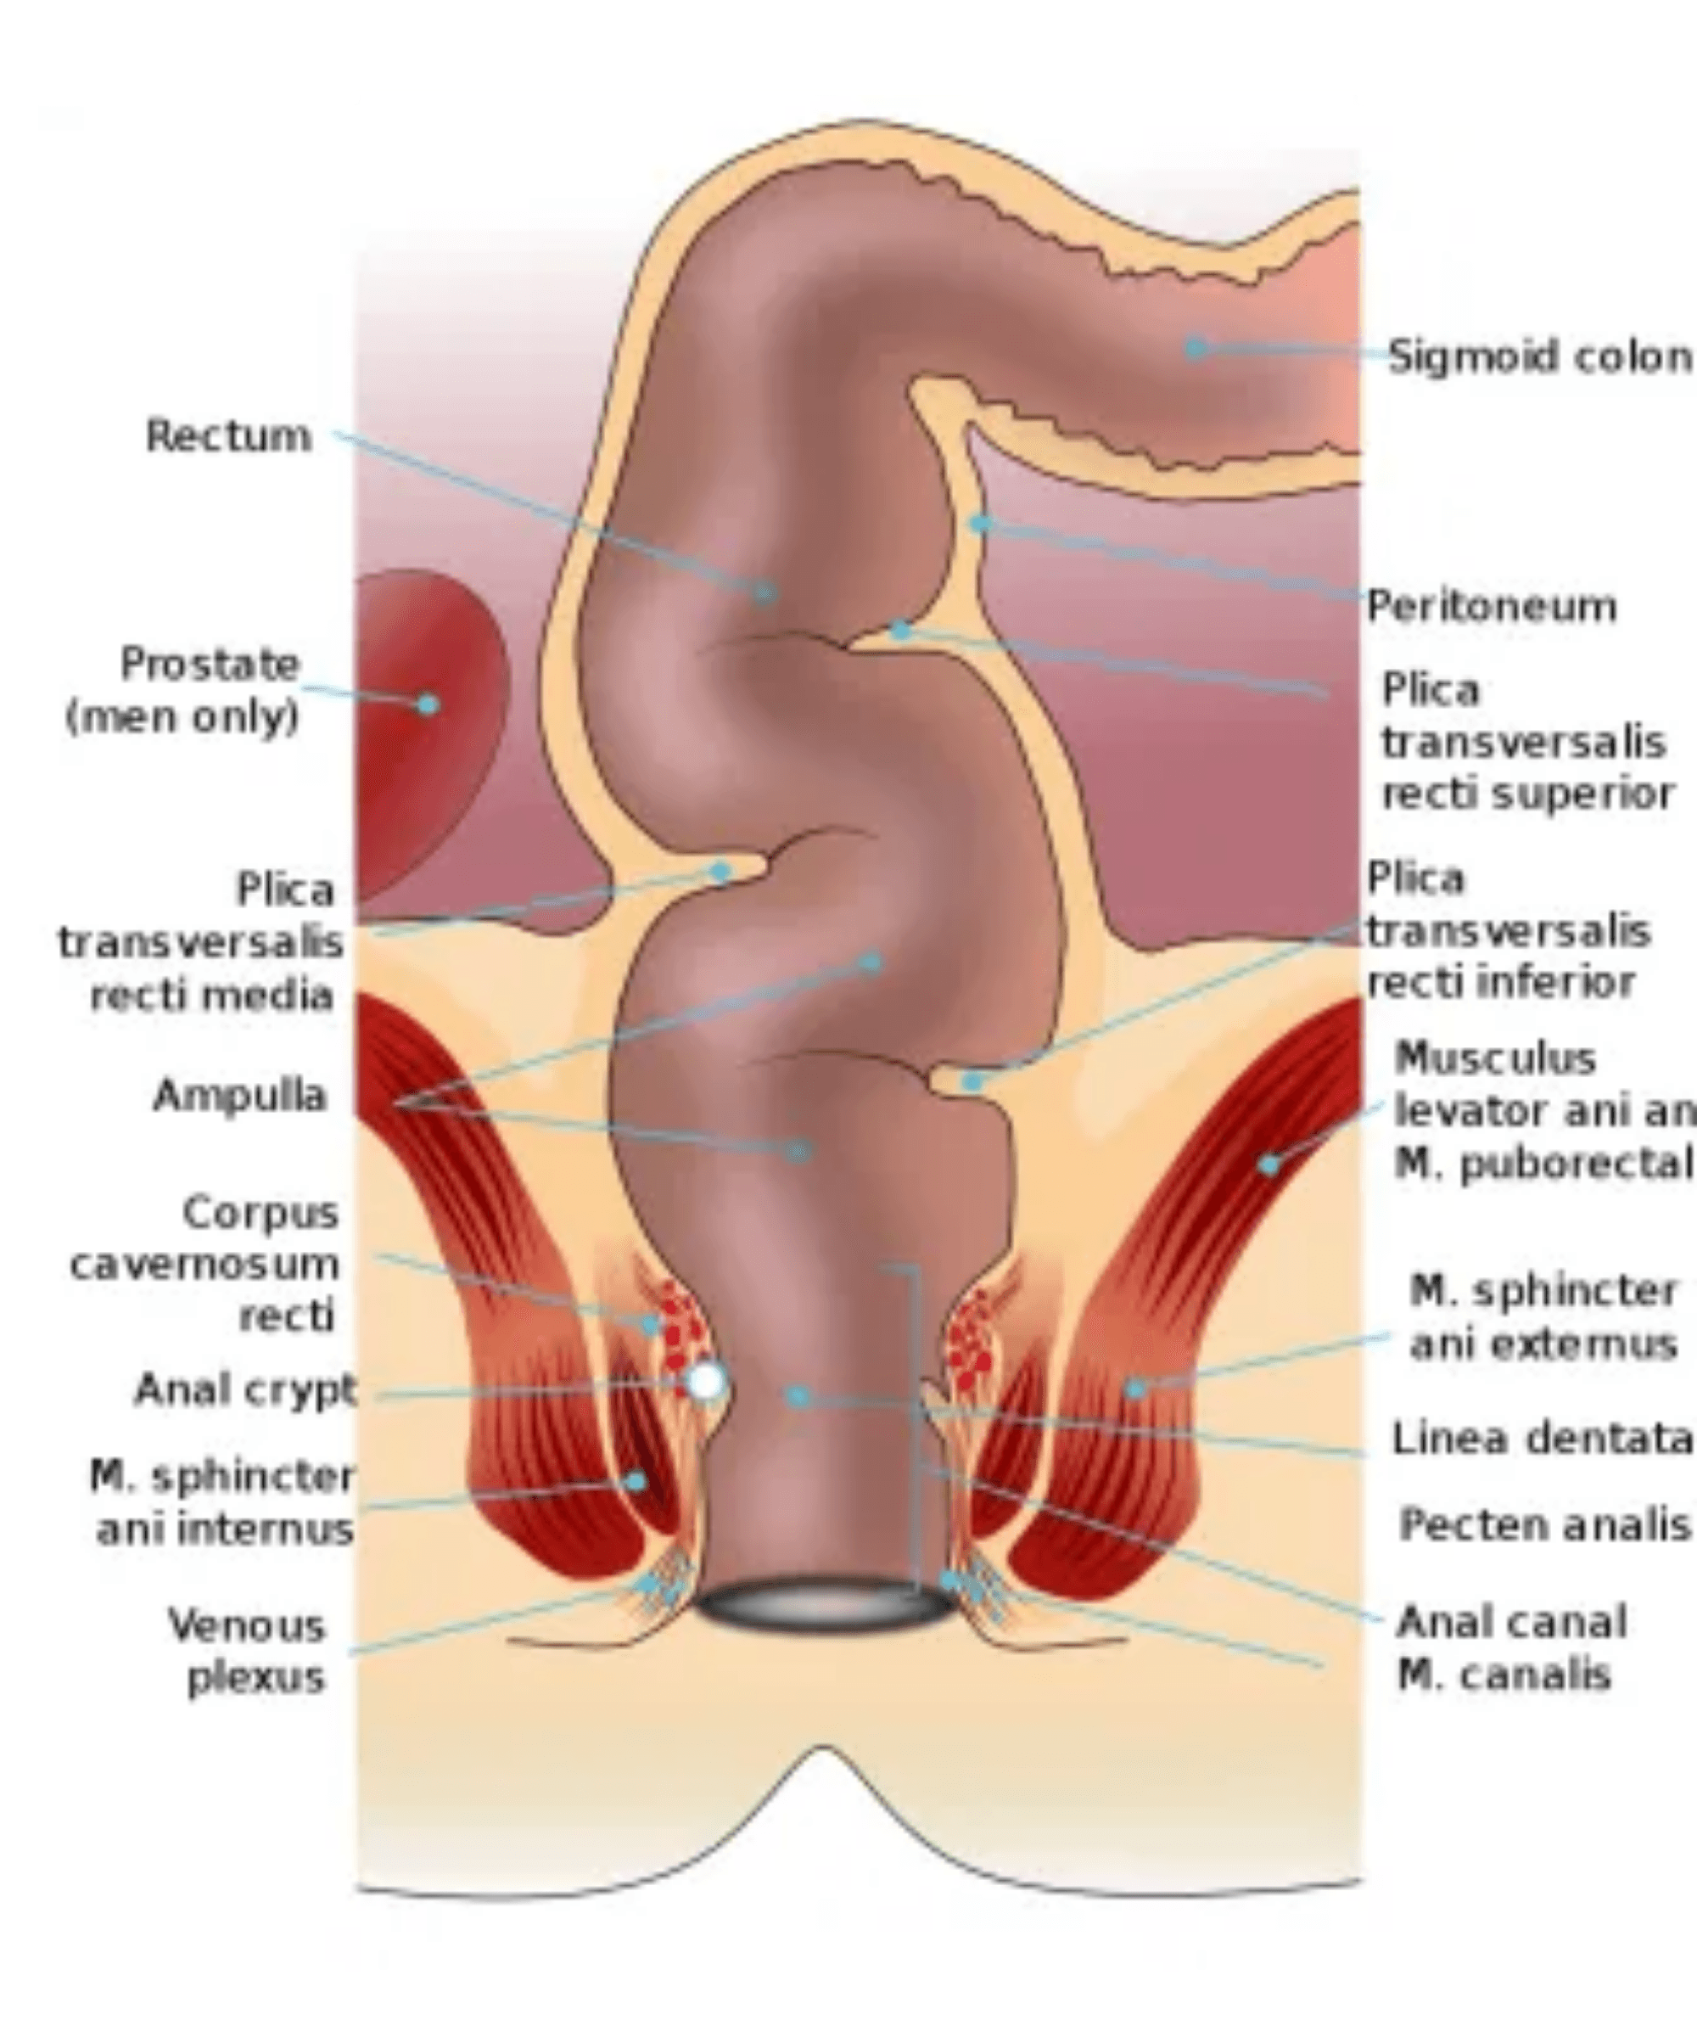
Anorectal Anatomy
Internal Sphincter
Involuntary smooth muscle, responsible for 70-80% of anal resting tone.
External Sphincter
Voluntary striated muscle allowing conscious control of defecation.
Dentate Line
Embryological junction; above is visceral (insensitive), below is somatic (highly sensitive).
Venous Plexus
Vascular cushions that aid in closure; the source of hemorrhoids when pathological.

Slide 3
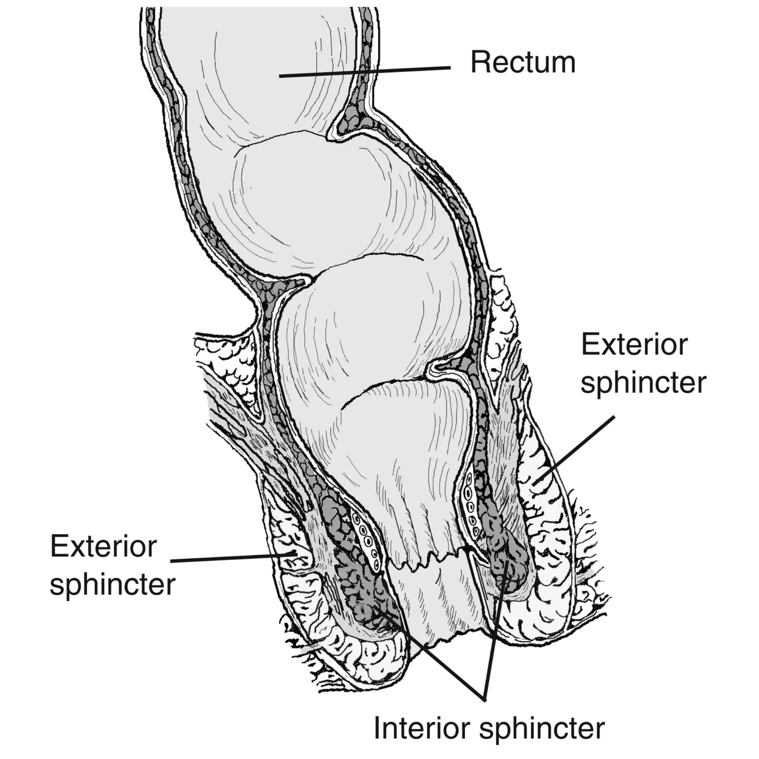



Preserving Continence
Every intervention must balance treating the disease with preserving sphincter integrity.
Resting Tone: Internal Sphincter (70-80%)
Voluntary Control: External Sphincter
Anal Sensation: Sampling reflex
Surgical Respect for Anatomy

Slide 4
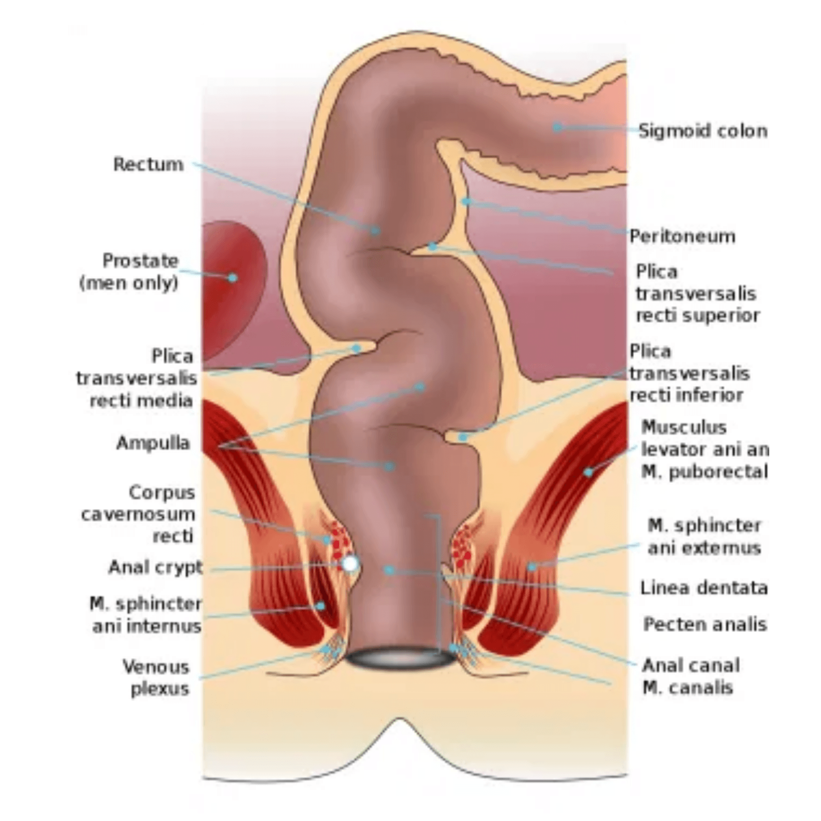




Hemorrhoids: ASCRS 2024 Grading
Internal hemorrhoids are graded based on the degree of prolapse and clinical presentation.
Grade I
Bleeding without prolapse.
Grade II
Prolapse with defecation, reduces spontaneously.
Grade III
Prolapse requiring manual reduction.
Grade IV
Permanent prolapse, non-reducible manually.

Slide 5





Medical Management (ASCRS 2024)
Behavioral and medical modifications are the cornerstone of treatment for early-grade hemorrhoids.
Fiber and Fluid Intake
25-35g fiber/day to reduce bleeding by >50%.
Toilet Habits
Avoid straining and prolonged sitting.
Stool Softeners
Bulk-forming laxatives for easier evacuation.
Topical Treatments
Short-term relief of acute symptoms (< 2 weeks).

Slide 6
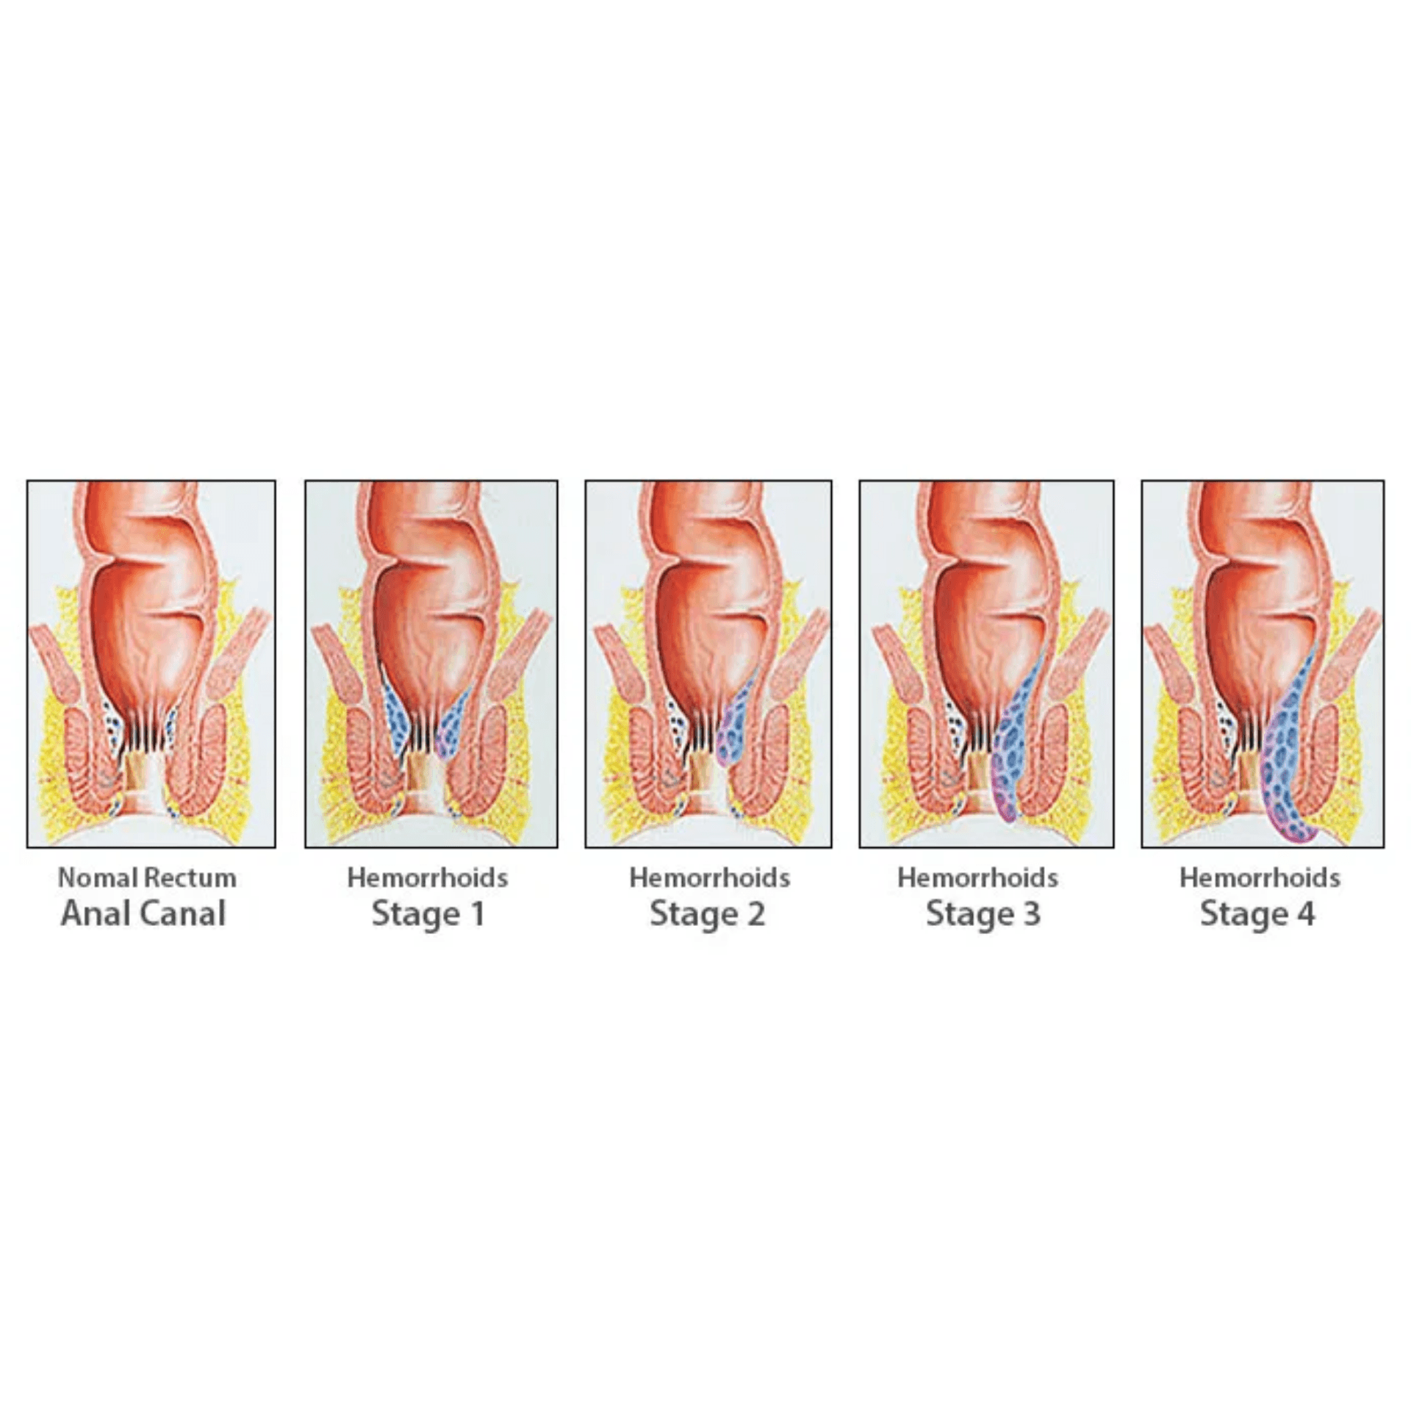



Office Procedures (Grade I-III)
Effective non-surgical options for early-grade internal hemorrhoids performed in the outpatient setting.
Rubber Band Ligation (RBL)
Most common; highest long-term success rates.
Sclerotherapy
Chemical injection; ideal for high bleeding risk.
Infrared Coagulation (IRC)
Thermal energy; less painful than RBL.

Slide 7




Surgical Hemorrhoidectomy
Reserved for advanced disease or failure of office-based treatments (ASCRS 2024).
Gold Standard
Indications
Closed Hemorrhoidectomy remains the benchmark for long-term success in treating advanced hemorrhoidal disease while minimizing complications.
Symptomatic Grade III-IV or recurrent thrombosis.
Preferred Technique
Closed Hemorrhoidectomy (less pain, faster healing).
Advanced Energy
Ultrasonic or bipolar devices reduce operative time.
Artery Ligation (DGHAL)
Effective alternative with less post-op pain.

Slide 8




Post-Operative Care
Effective management of pain and early complications is vital for patient recovery.
Recovery Focus
Multimodal Analgesia
Patient education on diet and hygiene is the most important factor in preventing recurrence and ensuring long-term surgical success.
NSAIDs, Acetaminophen, and limited opioids.
Sitz Baths
Warm water for comfort and hygiene.
Urinary Retention
Monitor voiding; limit perioperative fluids.
Fiber and Fluids
Essential to prevent constipation and straining.

Slide 9
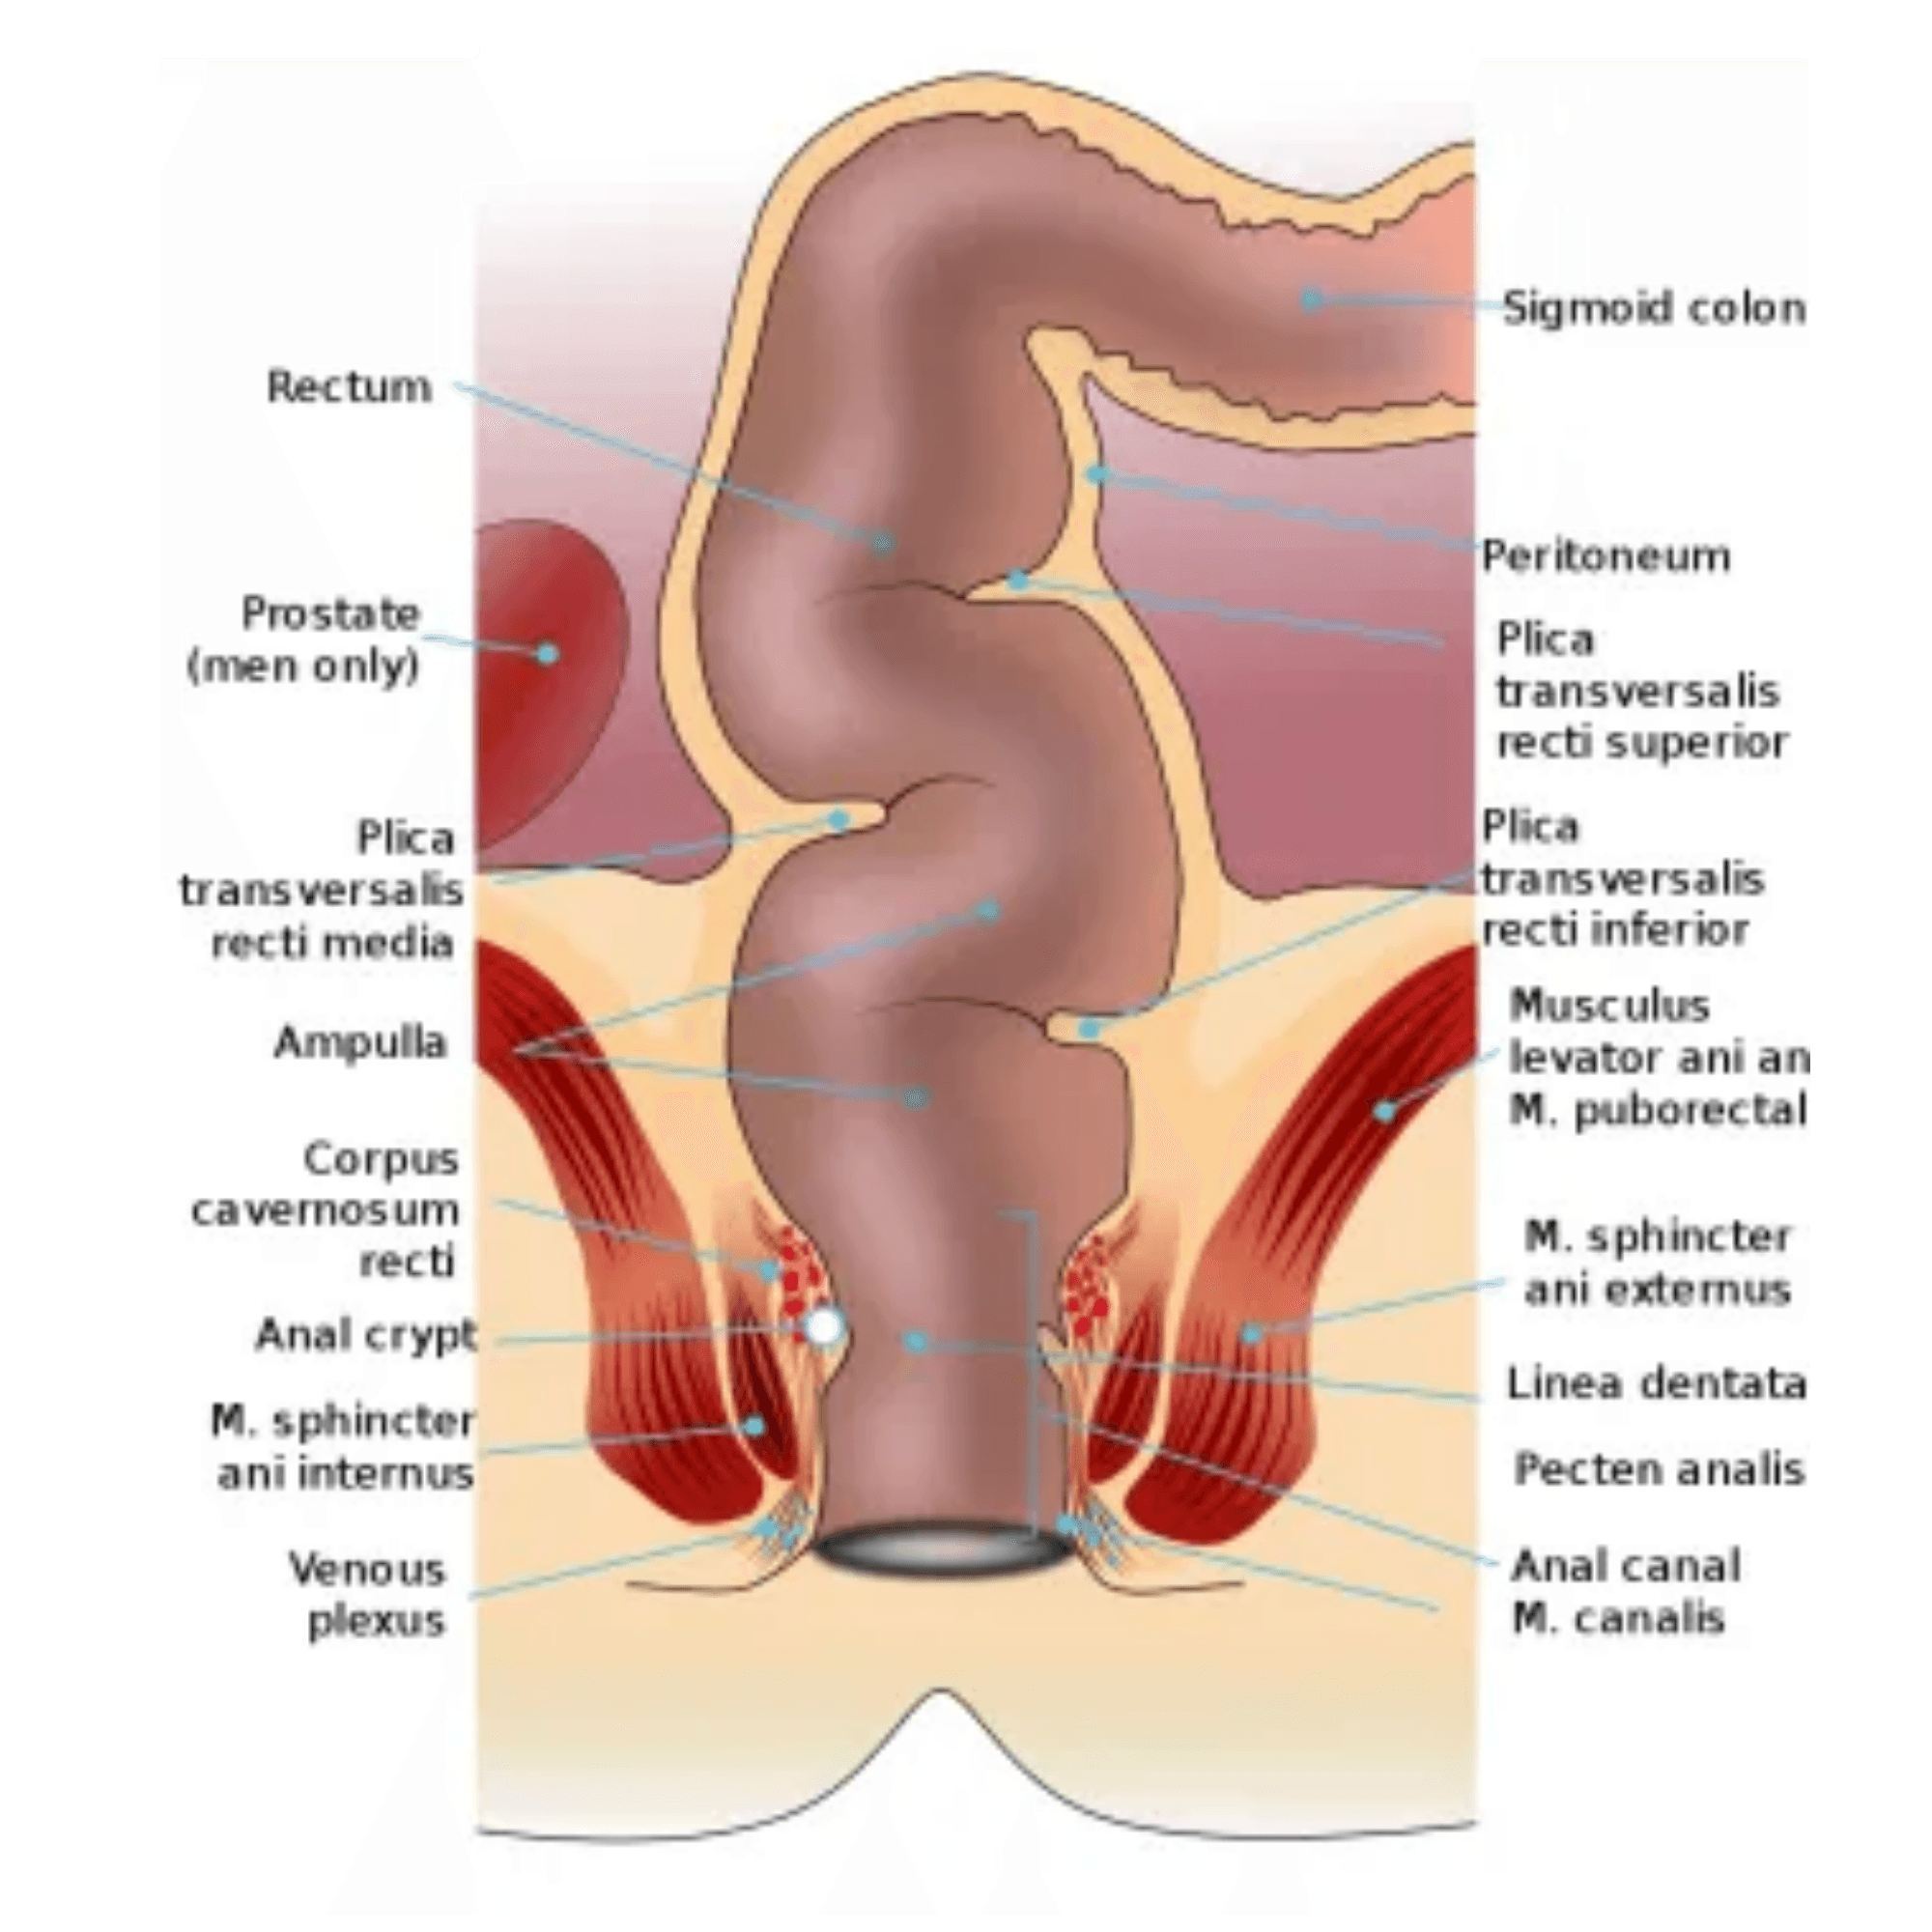




Anal Fissure
A linear tear in the distal anoderm, typically causing severe pain during and after defecation.
Acute: Sharp edges, < 6 weeks duration.
Chronic: Sentinel pile, exposed sphincter fibers.
Pathophysiology: Internal sphincter hypertonia.
Clinical: Bright red bleeding on toilet paper.

Slide 10



Medical Management (ASCRS 2023)
The primary goal is to relax the internal sphincter and improve local blood flow.
First-Line Therapy
Conservative Measures
Medical therapy should be attempted for at least 6-8 weeks before considering surgical options for chronic anal fissures.
Fiber, fluids, and Sitz baths (Grade 1B).
Topical CCBs
Diltiazem 2%; fewer side effects than nitrates.
Topical Nitrates
Effective but limited by headaches (20-30%).
Botulinum Toxin
Injection into the sphincter; high healing rates.

Slide 11
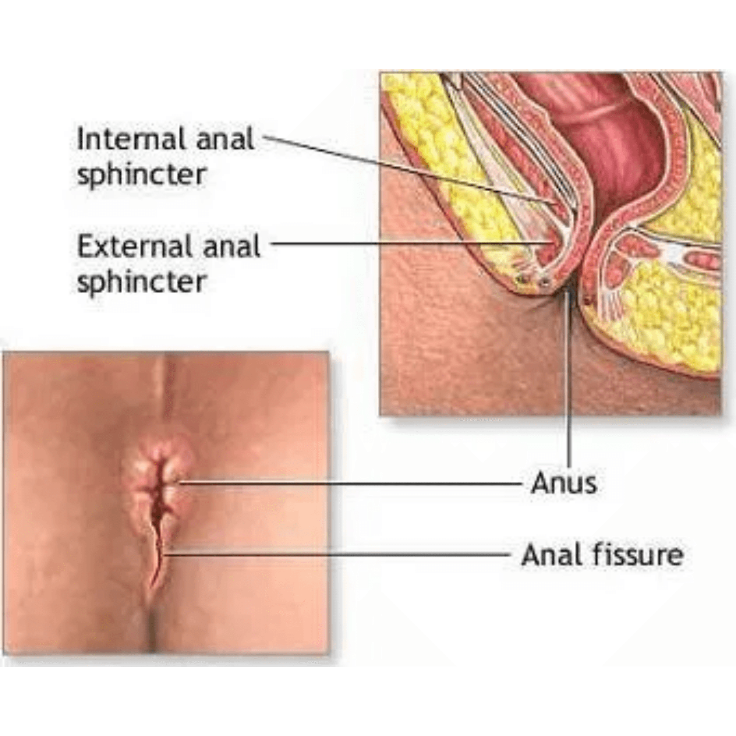




Surgical Options (ASCRS 2023)
Surgery is indicated for chronic fissures that fail to respond to medical therapy.
LIS: Gold standard for chronic fissure.
Healing rates: >90% success in most series.
Risk: Minor incontinence (flatus/seepage).
Flaps: Alternative for high-risk patients.

Slide 12





Abscess and Fistula
Two stages of the same disease process: acute infection vs. chronic tract.
Perianal Abscess
Clinical Rule
Acute phase; requires immediate incision and drainage.
"Where there is pus, let it out." Immediate drainage is the definitive treatment for perianal abscess to prevent necrotizing fasciitis.
Fistula-in-Ano
Chronic phase; abnormal communication between canal and skin.
The Connection
30-70% of abscesses will develop a chronic fistula.
Surgical Urgency
Drainage should not be delayed for antibiotics or imaging.

Slide 13





Fistula Management
The surgical goal is to eradicate the tract while preserving total fecal continence.
Surgical Priority
Parks' Classification
Complex fistulas involving significant sphincter muscle must be managed with sphincter-sparing techniques to avoid permanent incontinence.
Intersphincteric, Transsphincteric, Suprasphincteric.
Goodsall's Law
Predicts the path of the fistula tract.
Seton Placement
Drains infection and prevents recurrent abscess.
Sphincter Preservation
LIFT, Flaps, or Laser for complex fistulas.

Slide 14

Red Flags: When to Escalate the Case?
Suspicion of Malignancy
!
Unexplained weight loss
!
Persistent change in bowel habits
!
Palpable mass on DRE
!
Iron deficiency anemia
!
Family history of CRC/IBD
!
Symptoms in patients > 45-50 years
Acute Surgical Emergencies
!
Fever and systemic toxicity
!
Rapidly spreading cellulitis
!
Inability to void (Urinary retention)
!
Severe, intractable pain
!
Immunocompromised status (HIV, DM)
!
Massive rectal bleeding
Clinical Vigilance: Never assume rectal bleeding is "just hemorrhoids" without a complete evaluation, especially in older patients.

Slide 15

The Importance of Accurate Examination and Avoiding Common Errors
Systematic Examination Steps
Common Diagnostic Pitfalls
1. Systematic Inspection
The "Hemorrhoid Assumption"
Visual assessment of the perianal skin for redness, swelling, external hemorrhoids, skin tags, or visible fissures.
Error: Assuming all rectal bleeding is due to hemorrhoids without ruling out malignancy or IBD.
2. Digital Rectal Exam (DRE)
Incomplete Exam due to Pain
Assessment of sphincter tone, presence of masses, tenderness, and checking for blood on the glove.
Error: Skipping DRE or anoscopy in a pained patient. If too painful, consider examination under anesthesia (EUA).
3. Anoscopy
Missing Synchronous Lesions
Essential for evaluating internal hemorrhoids, the dentate line, and internal openings of fistulas.
Error: Focusing only on the obvious lesion (e.g., a fissure) and missing a concurrent abscess or fistula.

Slide 16

The Nursing Role in Perioperative Care
Pre-operative Preparation
Post-operative Monitoring
Discharge Education

Verify informed consent and patient identification.

Pain Assessment:

Use standardized scales; administer multimodal analgesia.
Dietary instructions: High fiber and adequate fluid intake.

Confirm bowel preparation (if ordered) and NPO status.

Hygiene: Proper Sitz bath technique and perianal care.

Voiding Status:
Monitor for urinary retention; encourage voiding within 4-6 hours.

Administer pre-operative medications and antibiotics as prescribed.

Medication adherence: Analgesics and stool softeners.

Wound Care:

Monitor for excessive bleeding or hematoma formation.

Assess baseline vital signs and anxiety levels.
Red Flags:
When to contact the surgical team (Fever, AUR, Bleeding).

Monitor vital signs for early detection of infection or hemorrhage.

Ensure patient has voided before transfer to the OR.

Follow-up appointment scheduling.

Slide 17
Interactive Clinical Case for Discussion
Patient Scenario
Discussion Questions
Basic Data
1. What is the most likely clinical diagnosis for this case?
A 45-year-old male with no chronic medical history presents to the ER complaining of severe, throbbing perianal pain that started 3 days ago.
2. Does this patient require an MRI before intervention?
Associated Symptoms
3. What is the immediate surgical action required? Should we wait for lab results?
Fever (38.5°C), chills, and difficulty sitting or defecating due to the intensity of the pain.
4. What are the essential nursing tips for this patient after the procedure?
Clinical Examination
A red, swollen, and extremely tender area (fluctuant mass) is noted adjacent to the anal opening.

Slide 18

Conclusion: Key Messages for Clinical Practice
Accurate Diagnosis is Key
Malignancy and IBD must be excluded in every patient with anorectal symptoms; never assume bleeding is just hemorrhoids without a thorough examination.
Stepwise Treatment Approach
Always begin with conservative management (fiber, fluids, sitz baths) for early-grade hemorrhoids and acute fissures before proceeding to surgical interventions.
The Surgical Balancing Act
The goal of surgery is cure while maintaining total fecal continence. Selecting the right technique for each patient minimizes the risk of permanent complications.
Collaborative teamwork between surgeons and nursing staff ensures the best outcomes and highest patient satisfaction.

Slide 19

Scientific References
Primary Sources (ASCRS Guidelines)
•
The American Society of Colon and Rectal Surgeons Clinical Practice Guidelines for the Management of Hemorrhoids (2024).
•
The American Society of Colon and Rectal Surgeons Clinical Practice Guidelines for the Management of Anal Fissures (2023).
•
The American Society of Colon and Rectal Surgeons Clinical Practice Guidelines for the Management of Anorectal Abscess, Fistula-in-Ano, and Rectovaginal Fistula (2022).
Thank You for Your Attention
The floor is now open for questions and discussion

