Slide 1


Slide 2
عدنا

Slide 3
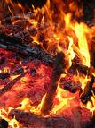
Burn basic facts and management principles part 2
BY
Tamer Rushdy
النار التى خوف الله بها عباده فى الآخره و جعلها ابتلاء للصالحين و انذارا للعاصين فى الدنيا

Slide 4
BURN CENTER ADMISSION CRITERIA
❏ total 2º and 3º burns > 10% TBSA in patients < 10 or > 50 years of age
❏ total 2º and 3º burns > 20% TBSA in patients any age
❏ 3º burns > 5% TBSA in patients any age
❏ 2º or 3º burns with threat of serious functional or cosmetic impairment (i.e. face, hands, feet, genitalia, perineum, major joints).

Slide 5
❏ inhalation injury (may lead to respiratory distress)
❏ electrical burns (internal injury underestimated by TBSA)
❏ chemical burns posing threat of functional or cosmetic impairment
❏ burns associated with major trauma

Slide 6
Today
Focus of burn treatment is then shifted to the definitive burn wound treatment and to the general support of the patient, which include:
Wound care and coverage
Nutritional support
Infection diagnosis and management
Rehabilitation and management of burn wound sequale

Slide 7
Emergency Escharotomy
Full-thickness circumferential burns result in the formation of a tough, inelastic mass of burnt tissue (eschar).
The eschar, may due to this inelasticity, results in the burn-induced compartment syndrome.
This is caused by the accumulation of extracellular and extravascular fluid within confined anatomic spaces
The excessive fluid causes the intracompartmental pressure to increase, resulting in collapse of the contained vascular and lymphatic structures and, hence, loss of tissue viability.

Slide 8
Indications Emergency Escharotomy,
The presence of a circumferential eschar with one of the following:
Impending or established vascular compromise of the extremities or digits.
Impending or established respiratory compromise due to circumferential torso burns

Slide 9
DECISION
Neurovascular integrity should be monitored frequently and in a scheduled manner.
Capillary refilling time, Doppler signals, pulse oximetry, and sensation distal to the burned area should be checked every hour.
Limb deep compartment pressures should be checked initially to establish a baseline.

Slide 10
DECISION
Subsequently, any increase in capillary refill time, decrease in Doppler signal, or change in sensation should lead to rechecking the compartment pressures.
Compartment pressures greater than 30 mm Hg should be treated by immediate decompression via escharotomy and fasciotomy, if needed.

Slide 11
Chest Escharotomy
When escharotomy is required in a patient with a circumferential chest wall burn, it is performed in the anterior axillary line bilaterally. If there is significant extension of the burn onto the adjacent abdominal wall, the escharotomy incisions should be extended to this area and should be connected by a transverse incision along the costal margin

Slide 12
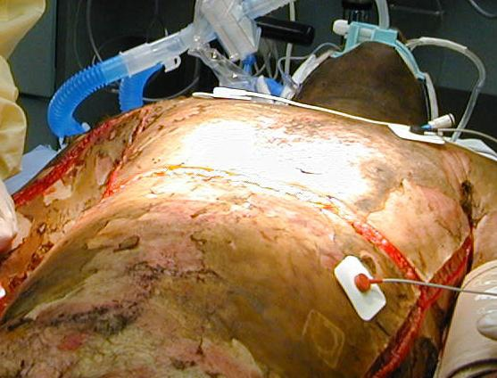

Slide 13
Escharotomy of Extremities
Local anesthesia is unnecessary because third- degree eschar is insensate; small doses of intravenous narcotics may be utilized to control anxiety.
The incision, which must avoid major nerves, vessels, and all tendons should extend through the eschar down to the subcutaneous fat.
Escharotomy is rarely required within the first 6 h postburn .

Slide 14
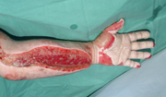

Slide 15
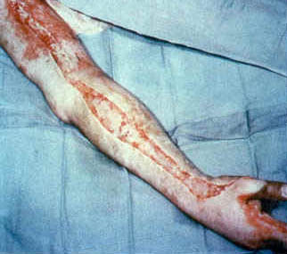

Slide 16
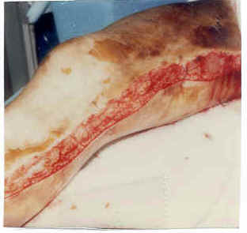

Slide 17
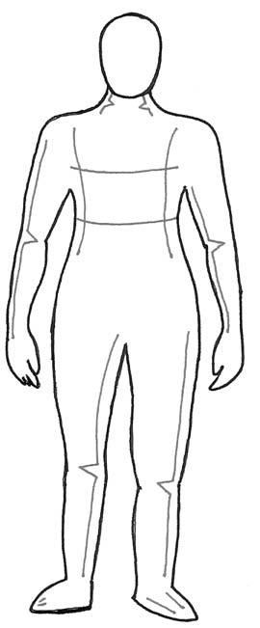
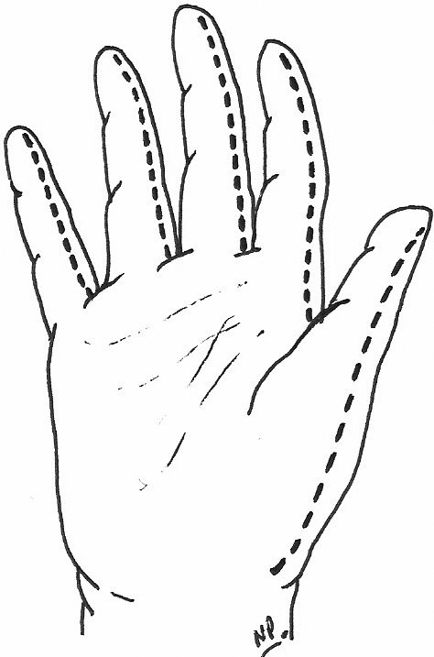

Slide 18
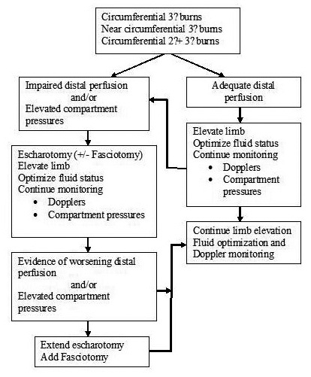

Slide 19
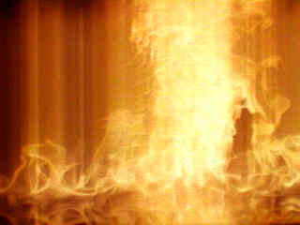
Burns WOUNDS

Slide 20
TREATMENT PLANNING
Treatment planning depends on the assessment of the following factors:
• Patient’s general condition and co-morbid factors
• Patient age
• Burn depth
• Burn size
• Anatomical distribution of injury

Slide 21
Treatment option | Burn depth
1-Topical antimicrobials 2-Biological dressings e.g human placenta 3-Skin substitutes e.g Biobrane® 5-exposure | Small /medium sized superficial partial thickness wound (< 40% TBSA)
1-Allograft 2-Xenograft 3-Topical antimicrobials | Large superficial partial thickness injury(> 40% TBSA)
excision and grafting Versus Topical antimicrobials | Deep partial thickness injury (small and large )
invariably require excision and skin grafting. | Full thickness injury

Slide 22
Topical Antimicrobial Therapy
Disadvantages | Advantages | Topical Agents
Lack of penetration | Painless | Silver Sulfadiazine
Painful, Carbonic anhydrase inhibitor | Penetrates | Mafenide Acetate
Limited penetration | Broad spectrum | Silver Nitrate
Impairs wound healing in high doses | Broad spectrum | Sodium Hypochlorite

Slide 23
Other agents
disadvantages | advantages | agent
Minimal coverage Often combined with polymyxin and neomycin into triple ointment | Gram-positive coverage | Bacitracin
 | Petroleum-based Keeps grafts moist | Polymyxin B

Slide 24
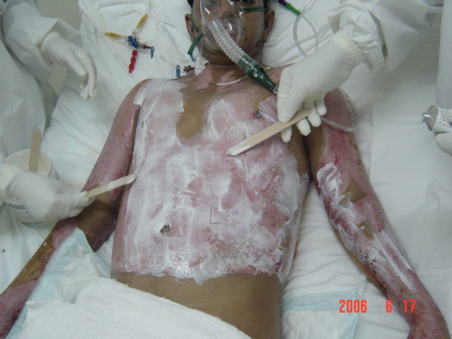
Flamazine Dressing

Slide 25
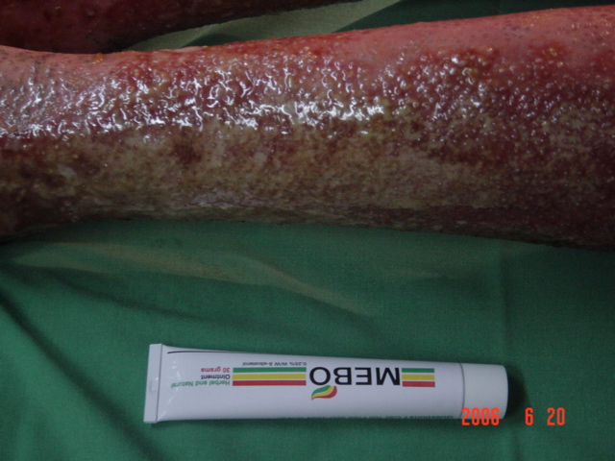
MEBO Dressing

Slide 26
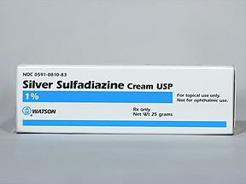

Slide 27
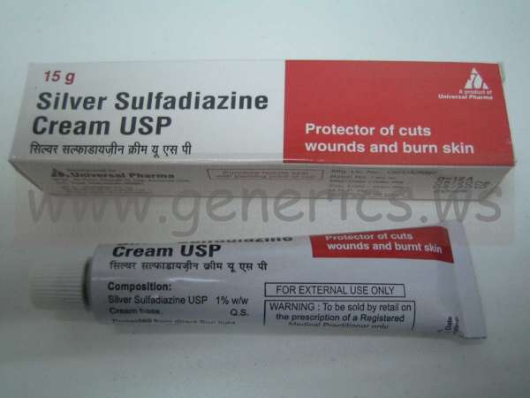

Slide 28
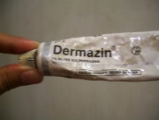

Slide 29
SKIN SUBSTITUTES
There are numerous products available and can be differentiated to those that provide temporary wound cover while the underlying wound re-epithializes or is ready for autografting (i.e., Biobrane®, Dermagraft TC®) and those that close the wound and help reconstitute part of the resultant skin (Integra®).

Slide 30
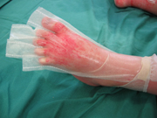

Slide 31
ALLOGRAFT SKIN (HOMOGRAFT)
usually harvested from cadaveric donors after appropriate donor selection and screening for communicable disease, and consent from relatives
has been obtained.
In order of preference of allograft take on the excised burn wound, fresh allograft is by far the best followed by cryopreserved, glycerolized, then freeze-dried.
Allograft skin can also be obtained from living donors, usually parents or relatives of burned children

Slide 32
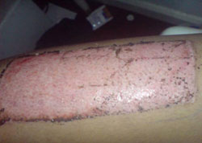

Slide 33
XENOGRAFTS
Skin from different species can be used for temporary physiological wound closure.
Pig skin is commonly used and is commercially available.

Slide 34
Exposure versus Closed Management
There are two methods of management of the burn wound with topical agents.
In exposure therapy, no dressings are applied over the wound after application of the agent to the wound twice or three times daily. This approach is typically used on the face and head. Disadvantages are increased pain and heat loss as a result of the exposed wound and an increased risk of cross-contamination.

Slide 35
Exposure versus Closed Management
In the closed method, an occlusive dressing is applied over the agent and is usually changed twice daily. The disadvantage of this method is the potential increase in bacterial growth if the dressing is not changed twice daily, particularly when thick eschar is present. The advantages are less pain, less heat loss, and less cross-contamination. The closed method is generally preferred.

Slide 36
Cultured Epidermal Autograft
In vitro culturing of epidermal cells (keratinocytes) produced a permanent skin and grafted onto a burn wound bed, closing massive wounds when donor sites were limited.
The first successful grafting was reported in children in 1986.

Slide 37
When the patient is admitted, a 1-cm skin biopsy specimen is usually sent to a commercial laboratory for culturing.
Three weeks later 5- by 5-cm 2 sheets of cultured cells are delivered.
CEAs are expensive.
Engrafted CEAs are poorly adherent and extremely fragile for months after application.

Slide 38
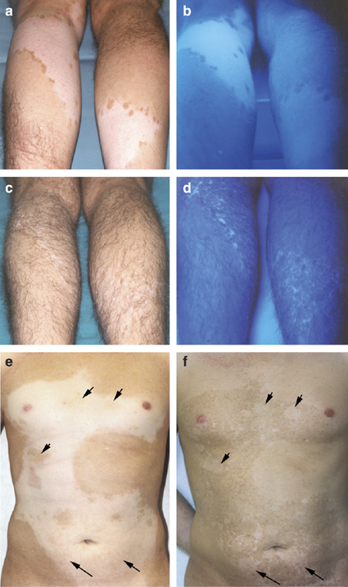

Slide 39
excision and grafting

Slide 41
Technical Considerations
EXCISION
Excisional procedures should be performed as early as possible after the patient is stabilized.
This allows the wound to be closed before infection occurs and, in extensive burns , allows donor sites to be recropped as soon as possible.
Cosmetic results are better if the wound can be excised and grafted before the intense inflammatory response associated with burns becomes well established.

Slide 42
Any burn projected to take longer than 3 weeks to heal is a candidate for excision within the first postburn week.
Wound excision is adaptable to all age groups, but infants, small children, and elderly patients require close perioperative monitoring.

Slide 43
Types
Excision can be performed to include the burn and subcutaneous fat to the level of the investing fascia (fascial excision), or by sequentially removing thin slices of burned tissue until a viable bed remains (sequential excision).

Slide 44
Tangential (Sequential) Excision
The principle is to shave very thin layers of burn eschar sequentially until viable tissue is reached.
The burn can be removed with a variety of instruments, usually power- or hand-driven dermatomes.

Slide 45
Tangential (Sequential) Excision
Slices are taken until a viable bed of dermis or subcutanbed does not bleed briskly, another slice of the same depth eous fat is reached.
If inspection of the dermal or fatty bed reveals a surface that appears gray or dull rather than white and shiny, or if there is evidence of clotted vessels, the excision should be carried deeper.

Slide 46
Any fat that has a brownish discoloration, has blood staining, or contains clotted blood vessels will not support a skin graft and must be excised until the bed contains uniformly yellow fat with briskly bleeding vessels.
Bleeding is controlled with sponges soaked in 1:10,000 epinephrine solution applied to the excision bed for 10 min.
Continued bleeding is then controlled with an electrocautery.

Slide 47
Fascial Excision
Fascial excision is reserved for patients with very deep or for patients with very large, life-threatening, full-thickness burns.

Slide 48
Advantages
(1) It results in a reliable bed of known viability.
(2) Tourniquets can be routinely used for extremities.
(3) Operative blood loss is less than with sequential excision.
(4) Less experience is required to ensure an optimal bed.

Slide 49
Disadvantages
(1) The operative time is longer.
(2) There may be severe cosmetic deformity, especially in obese patients.
(3) There is a higher incidence of distal edema when excision is circumferential.

Slide 50
Grafting broad lines
Skin graft junctures should be avoided over joints, and grafts should be placed transversely when possible.
Thick skin grafts yield a better appearance than thin skin grafts so should be used on the face, neck, and other cosmetically important areas.

Slide 51
Grafting
The resultant donor sites can be overgrafted with thin skin grafts to minimize hypertrophic scarring of the donor site.
Whenever possible, cosmetically important areas should be grafted with sheet skin grafts.

Slide 52
Grafting
Although meshed skin grafts provide cover with excellent function, the meshed pattern persists as a permanent reminder of the burn.
Adjacent pieces of skin graft should be approximated carefully.
While staples are adequate for areas in which cosmetics is not an issue, for critical areas, such as the face, suturing the edges together is preferred.

Slide 53
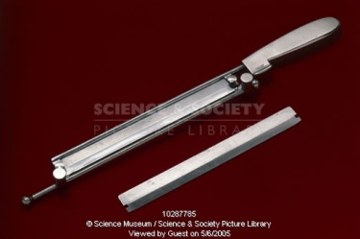

Slide 54
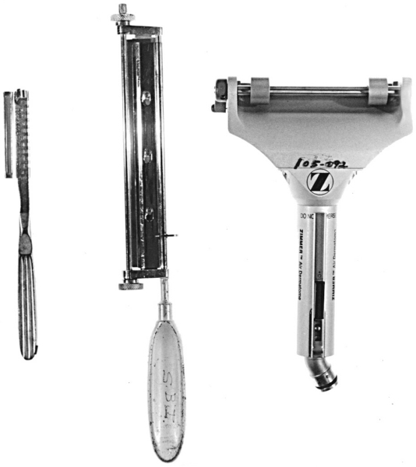

Slide 55
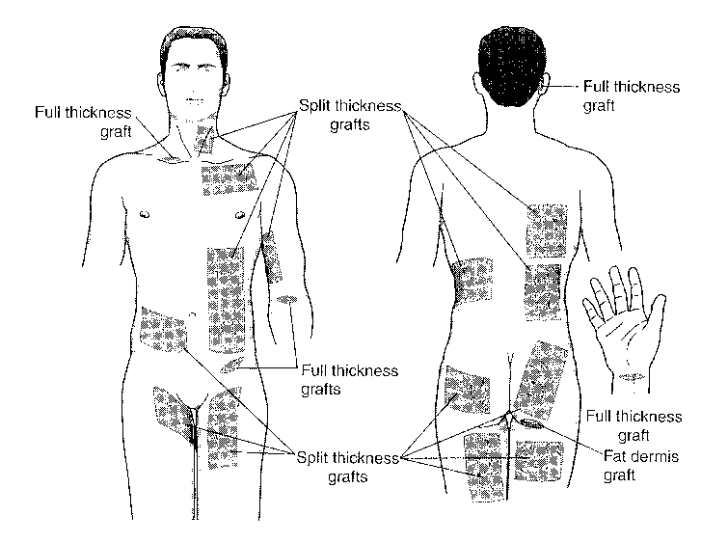
Available Skin Graft Donor Sites

Slide 56
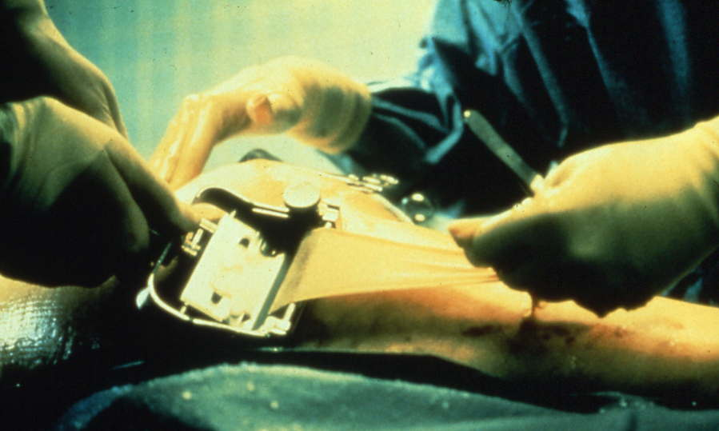

Slide 57
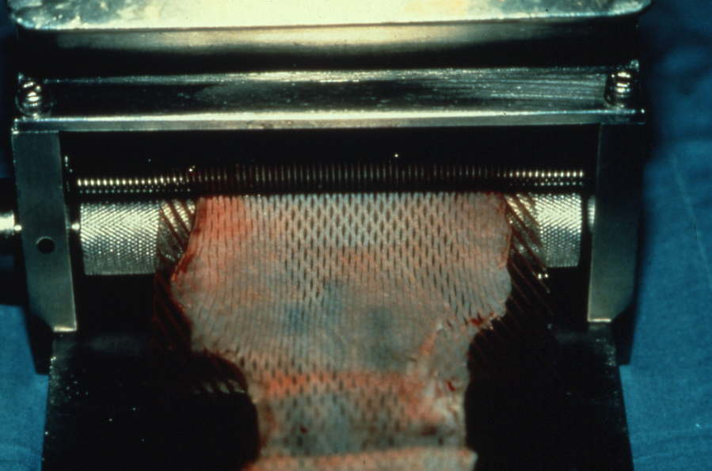

Slide 58
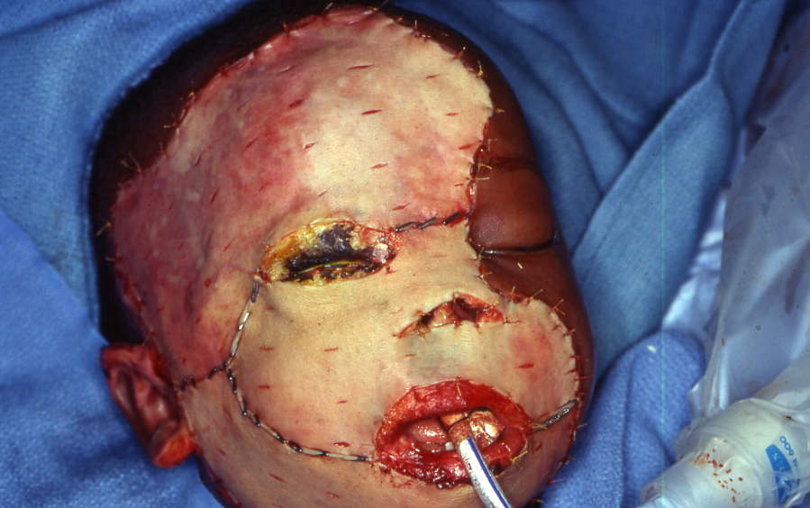
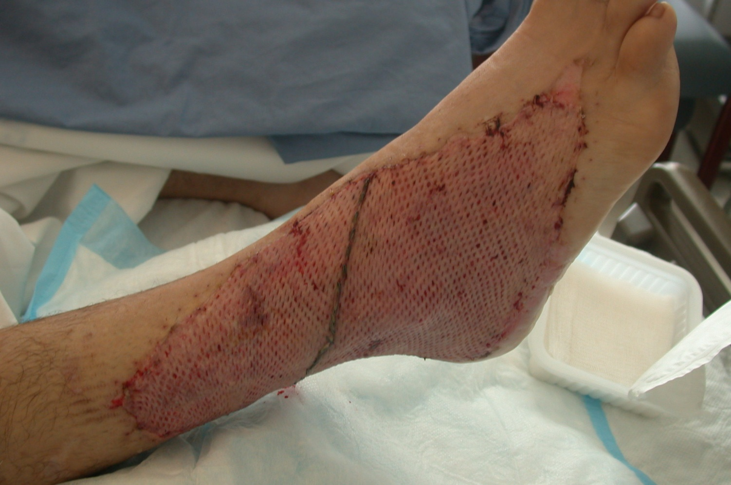

Slide 59
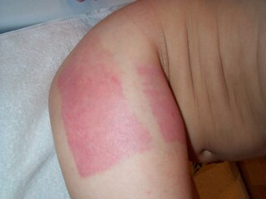

Slide 60
management of crititical areas

Slide 61

Face
Superficial burns of the face should be left exposed.
The face is washed twice daily with a mild soap and water, and a thin layer of a bland ointment (bacitracin) is applied to the open wounds to prevent drying.

Slide 62

Ears
Superficial burns of the ear should be treated with a bland ointment.
Deeper injuries must be treated with topical antibiotics; excessive pressure may cause chondritis, and should be avoided.

Slide 63
Eyes
Suspected corneal burns should be stained with fluorescein for confirmation of diagnoses.
Superficial corneal burns should be treated similarly to corneal abrasions, with vigorous irrigation, the application of ophthalmologic antibiotic ointment, and eye patching.

Slide 64

Hands
Superficial burns of the hand should be elevated for 24 to 48 h to minimize swelling.
Circumferential hand burns may require hospitalization for observation of adequate circulation.
Range-of-motion exercises should begin as soon as possible after injury.
.

Slide 65
Feet
Although burns of the feet are painful, walking and range-of-motion exercises should be performed. Crutches should not be allowed.
To prevent edema, burned feet should be elevated when the patient is not walking or exercising.
An elastic bandage should be applied over the wound dressing when the patient is walking or sitting, but it should be removed at night when the feet are elevated.

Slide 66
Perineum
Perineal burns frequently require hospitalization for 24 to 48 h for observation of urinary obstruction secondary to edema.
Minor perineal burns can be treated with a bland ointment.
Extensive superficial perineal burns, e.g., pediatric bathtub scald injuries, are best treated with topical (silver sulfadiazine), utilizing a diaper as the wound dressing.

Slide 67
Positioning of burn patient
To prevent contracture | Aim
Extended (no pillow) | Head and neck
apply eye ointment 3 times daily | Eyelids
apply moisturizing agent (Vaseline) | Lips
apply maintainer | Lip commissure
elevation and apply splint in functional position | Hand
(abducted ) | Axilla
dorsiflexed with foot support. | Foot

Slide 68
management of post- burn sequalae

Slide 69
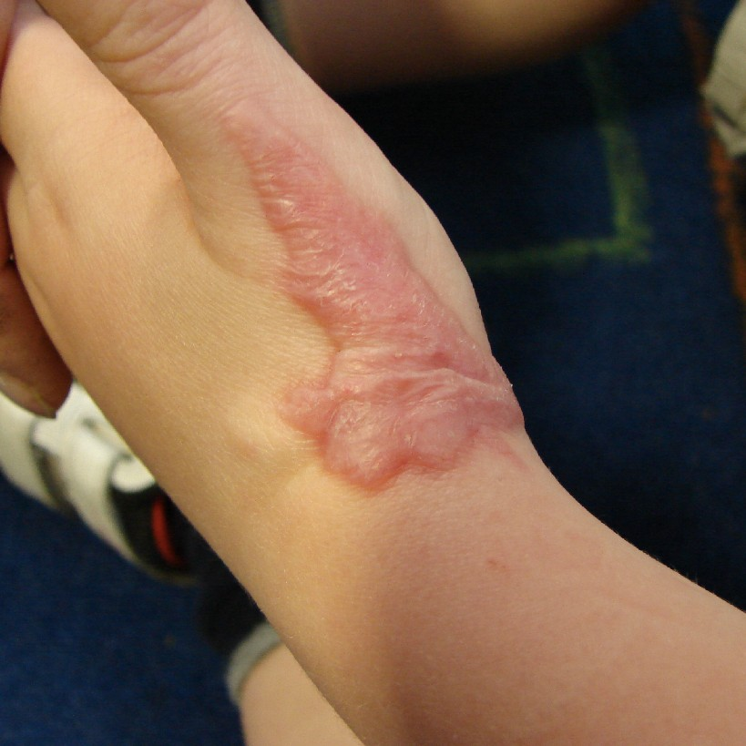

Slide 70
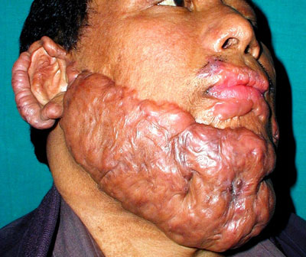

Slide 71
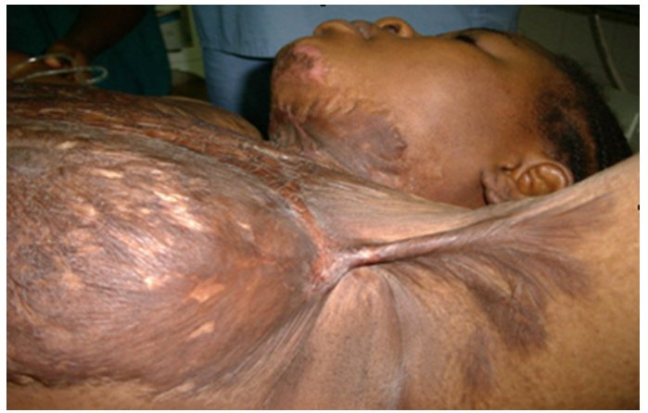

Slide 72
How to prevent hypertrophied scar and keloid:
1- Early release of tension over flexion creases of joints. Tension in a scar encourages hypertrophy, so that releasing it by grafting or local flaps may prevent its occurrence.
2- Continuous scar massage, after application of skin emollient, can be quite effective.

Slide 73
3- Pressure on maturing scar tissue, appears to reduce the incidence of hypertrophic changes. Such pressure is most likely maintained by compressive garments for 24hrs./day, for at least six to twelve months.

Slide 74
Treatment of an established keloid or hypertrophic scar
1- The release of the contracture by re-arranging
the tissues by local flaps (e.g.: Z- plasty) or by the
application of skin graft.
2- Intralesional steroid injection
(e.g.: triamcinolone acetonide; 1-2 cc of 40 mg./cc
at one or two weeks interval.). It inhibits collagenase
inhibitors causing degradation of collagen, thus
decreasing dermal thickening.

Slide 75
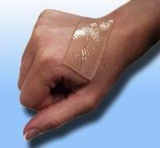
3- Application of silicone gel sheet as an occlusive dressing.
Ideally it should be placed 24hrs./day for about a year.

Slide 76
5- Laser therapy :
The modalities are :
- Pulse-dyed laser ----- microvascular thrombosis
- CO2 laser & Argon laser----- collagen shrinkage
through heating.
- Nd-YAG laser----- inhibits collagen metabolism and production.
However the recurrence rate with laser therapy is high.

Slide 77
6- Interferon therapy : The newest therapeutic
modality on the horizon is intralesional injection Of Interferon.
They reduce fibroblast synthesis and collagen
type I, III and possibly IV and increase the
collagenase activity.

Slide 78
Management of burn sequelae
in specific regions
1- Head and Neck
2- Upper extremity
3- Lower extremity
4- Trunk

Slide 79
Scalp
3- Reconstruction :
a- Minor defect: advancement and rotation of adjacent scalp flaps will be enough to fill the defect.
b- Moderate defect: Tissue expansion is the final treatment of choice. This allows the area to be reconstructed with like tissue and with no donor defect.

Slide 80
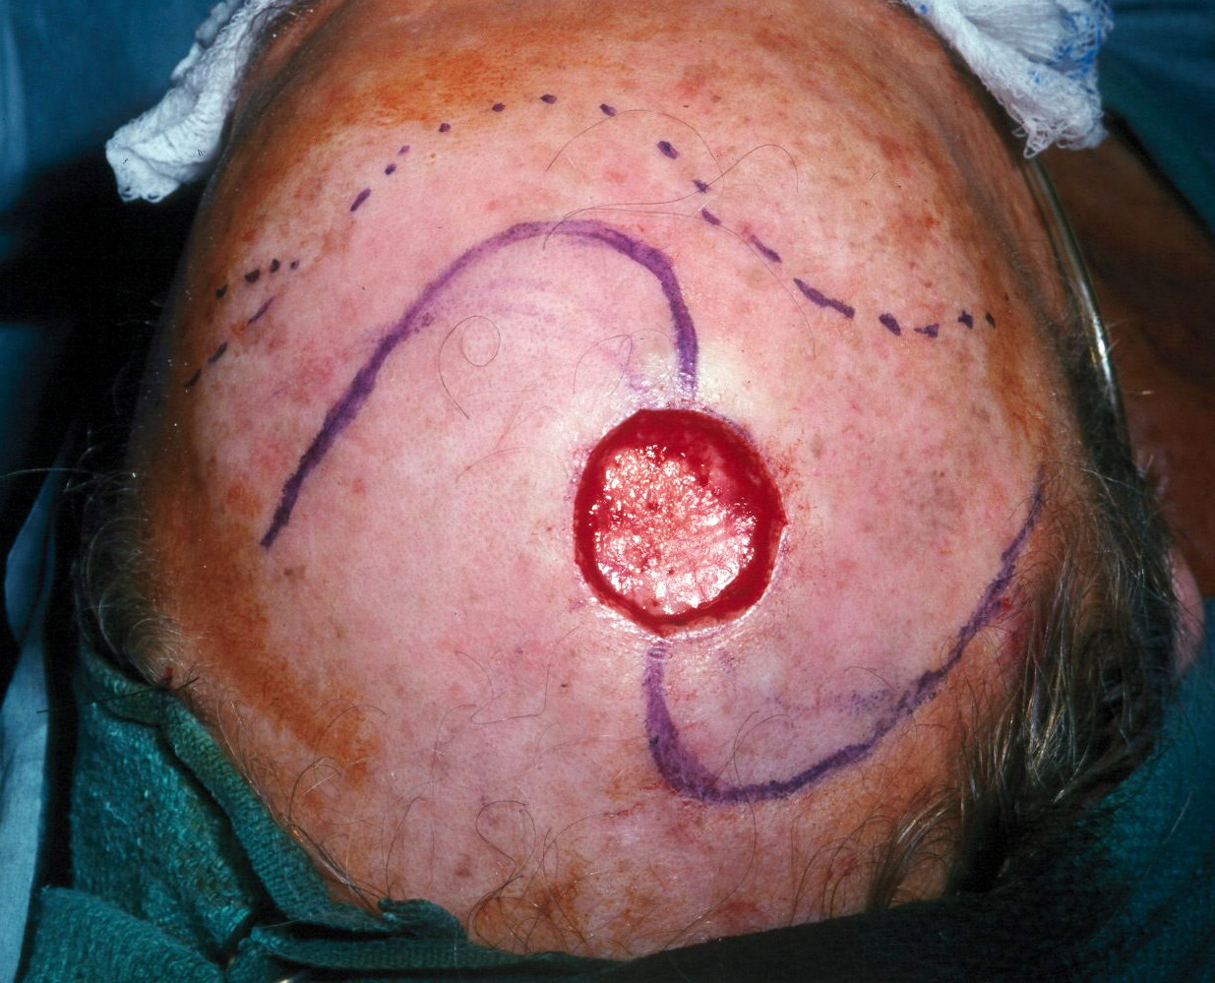

Slide 81
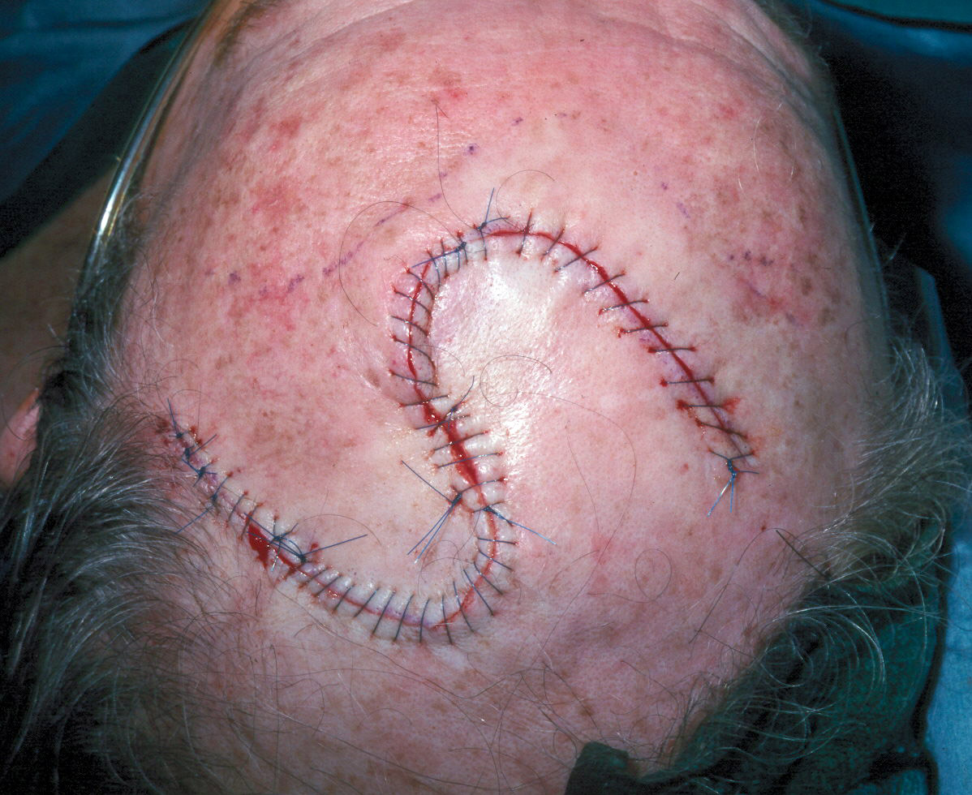

Slide 82
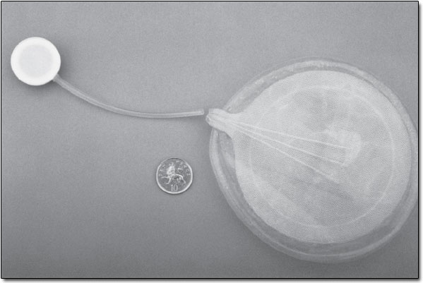

Slide 83
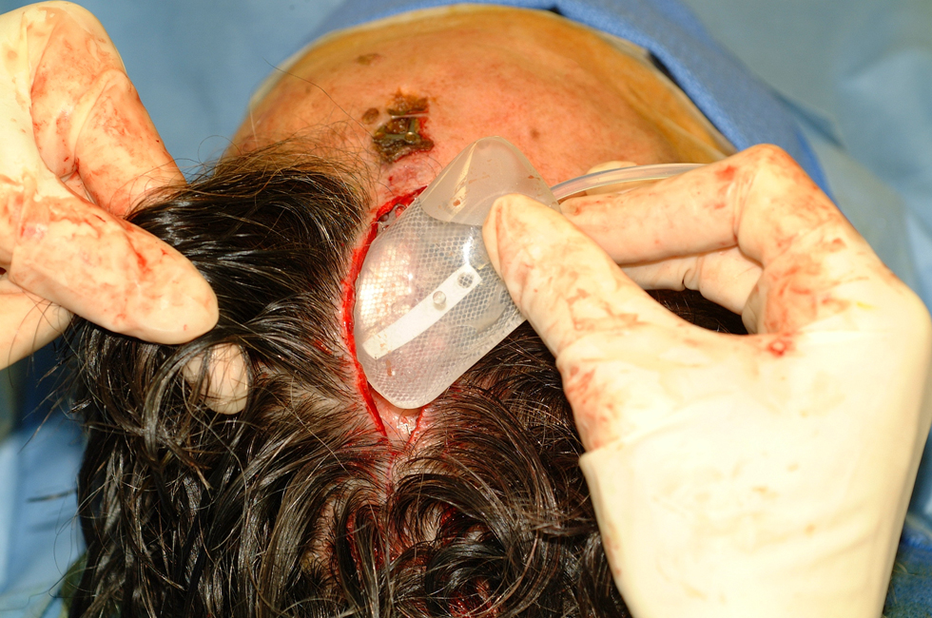

Slide 84
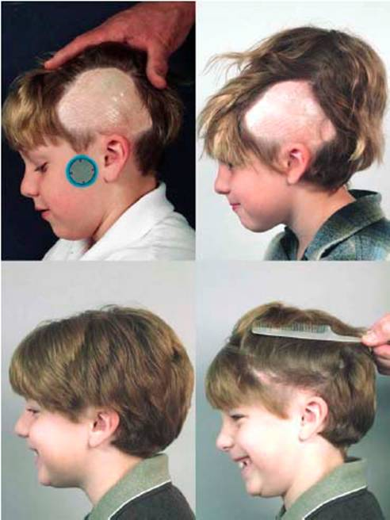

Slide 85
c- Extensive defect: This is a difficult situation. Defects in this range may be too large to be corrected by tissue expansion. If periosteum is intact, a skin graft is applied. Otherwise free tissue transfer is required. The most common flaps are the omentum and the latissimus myocutaneous flaps.

Slide 86
Face
1- The forehead : is best resurfaced with a
single sheet of split thickness skin graft.
With bony exposure or destruction, flap
reconstruction is indicated.
2- The cheeks : the best is tissue expansion
from adjacent non-injured tissue (e.g.: neck).
Thin free flaps may be considered (e.g.: radial
forearm flap). Others describe the use of a
large full-thickness graft as one aesthetic unit.

Slide 87
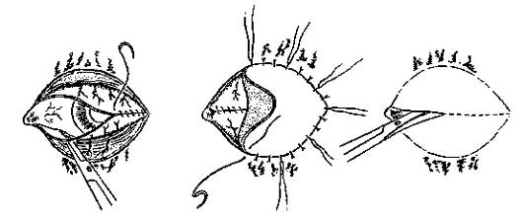
Eye lid
Eye lid reconstruction :
Indications : exposed cornea, contractor ectropion of upper and/or lower eye lid and contractures at the canthi regions.
1- Total loss of eye lids : the exposed cornea can be covered by mobilizing the conjunctiva which is covered with skin graft. Later on the lids can be reconstructed with local flaps (e.g.: cheek flap or
median forehead flap
with septal
mucoperichondrial graft
as lining).

Slide 88
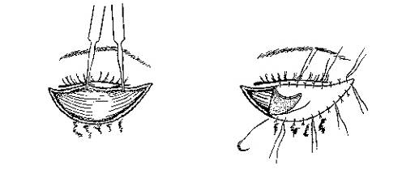
2- Ectropion :
we have to distinguish between :
a- primary ectropion where the deep burn affects the eye lids directly. The treatment is release of the contrature and application of thick split thickness graft to the upper eye lid and a full thickness graft to the lower eye lid.

Slide 89
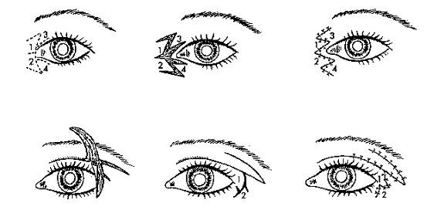
b- secondary ectropion, due to contracture of forehead, cheek or neck pulling on the eye lids. Treating the cause will alleviate the condition.

Slide 90
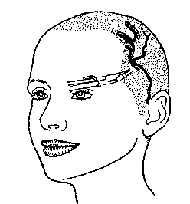
Eye brow
Eye brow reconstruction :
* Loss of the hair may be compensated by the simple simulation done by an eye brow pencil ( specially in women ).
However surgical reconstruction of the eye brow may be done through :

Slide 91
1- Hair transplantation: single hair transplantation is better than a punch graft.
2-Hair-bearing flap from the temporal scalp. It is based on the superficial temporal artery and it is an island flap.

Slide 92
3- Strip graft taken anywhere from the hairy scalp with the dimension and shape of the eye brow. Care is taken :
- not to exceed 4 mm. in width.
- not to injure the hair follicles during elevation of the flap by the scalpel.
- the direction of the hair should be oriented from medial to lateral.

Slide 93
Lip and mouth
Lip and mouth reconstruction :
1- Extensive scarring of the upper or lower lip:
excision and full thickness graft within the
aesthetic unit of the involved lip.
2- Microstomia (oral commissure contracture):
corrected by full thickness incisions at each angle
of the mouth as far as a line dropped vertically
from the pupil of the eye. Then the oral mucosa

Slide 94
is mobilized and everted onto the lip skin, forming
a new commissure. Some overcorrection is
generally advisable.

Slide 95
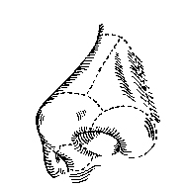
Nose
Nasal reconstruction :
1- Total destruction of the nose requires :
a- Flap reconstruction either
regional, like the forehead flap,
or distant by microvascular transfer.
b- Prosthetic reconstruction.
2- Unacceptable hypertrophic or hypopigmented
scars over a large surface of the nose may be
treated by dermabrasion, either mechanical or by
laser, and application of a single sheet of skin
graft within the nasal aesthetic units.

Slide 96
3- Alar rim reconstruction is done using a composite graft from the ear.
4- Nostril stenosis is treated by release and skin grafting. Splints must be worn for at least six months after surgery to prevent recurrence.
5- Web contracture between columella and upper lip, may be released by V-Y advancement flap.

Slide 97
Ear
Ear reconstruction:
- Indications: Partial or total loss of the external
ear.
- Classification: Help to determine the treatment.
Mild defect: loss of helix and upper part of the
auricle, without extensive scarring.
Moderate defect: concha nearly normal; upper half
of the ear missing; antihelix and its posterior crura
missing.
Severe defect: remnant of concha; local soft tissue
scarred; external ear orifice normal or stenosed.

Slide 98
Head & neck reconstruction
(Ear reconstr.)
Treatment :
1- Total absence of the auricle :
- Surgical reconstruction using a costochondral
graft, as described for microtia.
- Osteointegrated prosthesis.
2- Subtotal absence of helical rim :
- Local flap reconstruction is preferred.
- When the entire helix is missing, a tubed
cervical skin flap is used.

Slide 99
3- Ear lobe deformity:
- Adherence of the ear lobe to the neck is the main
deformity. Z-plasty or local flaps are generally
sufficient for correction.
4- Meatal stenosis :
- Splinting may be used as a preventive measure
and may eliminate the need for surgical
correction
- After release, use local flaps if available. If not
use skin graft.
- A conformer is worn by the patient for 4 - 6
months to prevent recurrence.

Slide 100
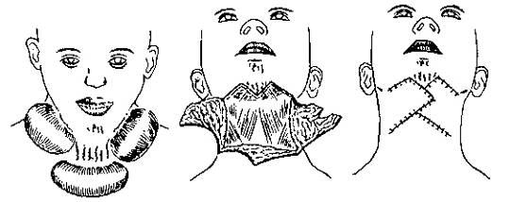
Neck
* Treating established contractures :
1- Mild cases: mild scar bands can generally be corrected surgically by using local flaps or Z-plasties.
2- Moderate cases: contractures involving 1/3 - 2/3 of anterior neck, can be treated using tissue expansion. The unscarred lateral aspects of the neck are expanded.

Slide 101
3- Severe cases: contractures involving more than 2/3 of the anterior neck, are better treated by release and split thickness skin graft or distant flap by microvascular technique. Local flaps are not adequate.

Slide 102
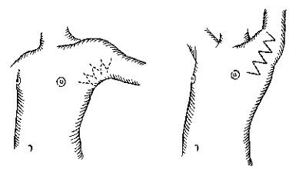
Axilla
* Treating established contractures :
1- Scar bands and minor contractures are better
treated by local flaps e.g.: Z-plasty or V-Y plasty.
They may be combined with the application of
skin graft, kept in place by tie-over dressing.

Slide 103
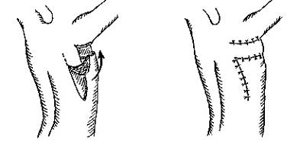
* Treating established contractures :
2- Moderate contracture may be released and the
defect filled with a latissimus dorsi fasciocutaneous
flap.

Slide 104
* Treating established contractures :
3- Severe contracture, producing large defect on
release, are best treated with skin graft.

Slide 105
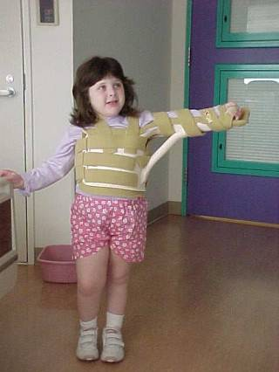
Plaster of paris is applied at the end of the operation where the joint is kept as fully abducted as possible.
Splintage should be maintained for several weeks until the patient can put the joint through a full range of movement.

Slide 106
    Clinically any change in patient’s general status should lead to high suspicion of sepsis:
    1) Unexplained hypotension.
    2) Tachypnea.
    3) Spiking fever.
    4) Tachycardia.
    5) Ileus.
    6) Altered mental state.
    7) Thrombocytopenia.
    8) Hyper or hypoglycaemia.
    9) Hypoxia.
    10) Hypothermina.
    11) ↓ Urine output.
    12) Progressive leucocytosis.
    13) Leucopenia.

Slide 107
    Management of clinically septic patien
    1) Support of cardiopulmonary and G.I. systems.
    2) Eschar debridement.
    3) Empiric antibiotic.
    4) Send for culture/sensitivity.
    5) Adequate fluid to maintain intravascular volume.
    6) Invasive monitoring.
    7) Change in frequency of dressing.
    8) Change in topical antibiotic.
t

Slide 108
Wound Infection
Before the availability of penicillin, streptococci and staphylococci were the predominant infecting organisms.
By the late 1950s, gram-negative bacteria ( Pseudomonas species) had emerged as the dominant organism causing fatal wound infections in burn patients.

Slide 109
Wound Infection
All burn wounds become contaminated soon after injury with the patient's endogenous flora or with resident organisms in the treatment facilities
The likelihood of septicemia increases in proportion to the size of the burn wound.

Slide 110
Pneumonia
One result of the prolonged survival of severely burned patients in critical care units, made possible by modern patient support techniques, is that the respiratory tract has become the most common locus of infection
A diagnosis of pneumonia is confirmed by the presence of characteristic chest radiograph patterns, and the presence of offending organisms and inflammatory cells in the sputum
For the diagnosis of bronchopneumonia, analysis of sputum samples may be adequate

Slide 111
Suppurative Thrombophlebitis
Suppurative thrombophlebitis is a major cause of sepsis in burn patients, occurring in up to 5 percent of patients with major burns.

Slide 112
Bacterial Endocarditis
Endocarditis is occasionally the cause of occult sepsis in burn patients, and its incidence continues to rise with the increasing use of intravenous catheters for hemodynamic
monitoring. Endocarditis should be suspected in patients with positive blood cultures and no other identifiable source of bacteremia. These patients should be examined repeatedly
by echocardiography until the source of the septicemia is identified.

Slide 113
UTI
Most patients with burns greater than 20 percent TBSA require indwelling urinary catheters to guide fluid resuscitation.
Aseptic techniques of insertion and catheter care, the use of a closed drainage system, and the removal of the catheter at the earliest clinically indicated time are effective measures for preventing urinary tract infections.

Slide 114
Chondritis of the Ear
The pinna of the ear is composed almost entirely of cartilage with minimal blood supply and is vulnerable to infection.
It is a rare complication.
When chondritis does occur, conservative approach with drainage of the helix centrally, in an attempt to preserve the outer cartilages, is usually successful.

Slide 115
NUTRITIONAL SUPPORT
The nutritional effects of the hypermetabolic response to thermal injury are manifested as exaggerated energy expenditure and massive nitrogen loss.
Nutritional support is directed primarily toward supply of calories to match energy expenditure and provision of nitrogen to replace or support body protein stores.

Slide 116
Caloric requirements in adult burn patients are calculated using the Curreri
formula, which calls for 25 kcal/kg/day plus 40 kcal/% TBSA burned/day.

Slide 117
Route of Administration
Patients with burns under 25 percent TBSA that are not complicated by facial injury, inhalation injury, or malnutrition, and are not associated with psychological difficulties can usually be maintained on high-calorie, high-protein diets ingested orally.
The nutritional requirements of patients with large burns cannot be met by the oralroute alone, and these patients should be fed gastrointestinally or nasoenterally.

Slide 118
A functionally intact alimentary tract always should be used.
Enteral nutrients seem to maintain the integrity of the gastrointestinal tract, and increased hepatic protein synthesis may reduce the incidence of bacterial translocation from the gut.

Slide 119
An oral diet preserves gut mucosal mass and maintains digestive enzyme content; parenteral feeding results in decreased mucosal cell turnover.
Total parenteral nutrition should be instituted when enteral feedings alone cannot provide adequate nutritional support

Slide 120

Thanx

Slide 121
FIN

