Slide 1
ORIENTATION
HERNIA
CAUSES
PARTS
COMPLICATIONS
SITES
VENTRAL HERNIA
UMBILICAL&PARAUMBILICAL HERNIA
CONGENITAL&ACQUIRED

Slide 2
HISTORY
OCCUPATION
MARITAL STATUS
SMOKING
SWELLING IN ……. &………AGO
Cough,micturation,constipation
H. Of operations

Slide 3
LOCAL EXAMINATION

Slide 4
INSPECTION
Standing,supine
Exposure
Site
Special ch.ch.(impulse,reducible)

Slide 5
PALPATION
Special ch.ch.
DEFECT

Slide 6
PERCUSSION
content

Slide 7
AUSCULTATION
content

Slide 8
DIAGNOSIS
PUH(SITE,CH.)
EPIG.H.(ONLY SITE,STANDING WITH PULP OF INDEX OVER LINEA)
INCISIONAL(LIKE PUH+SCAR+PF)
NON COMPLICATED

Slide 9
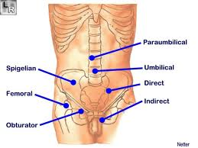

Slide 10
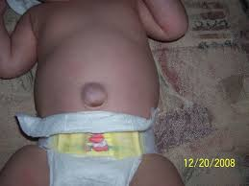

Slide 11
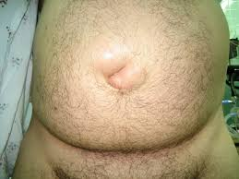

Slide 12
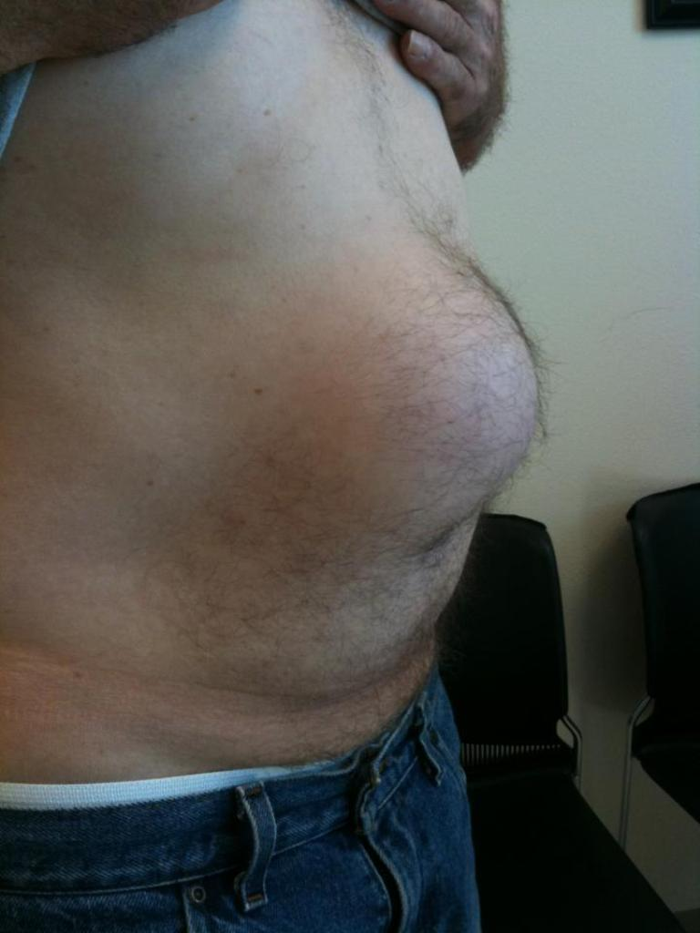

Slide 13
Q
CONTENT
CAUSES
COMPLICATIONS
TREATMENT(TYPES,WHERE TO OPEN SAC,MAYO,`HERNIOABDPLASTY)
COMMENEST H IN FEMALE
OBESITY AND PUH
PUH AND EPIG H
PUH AND IRREDUCIBILITY

